Slide 1
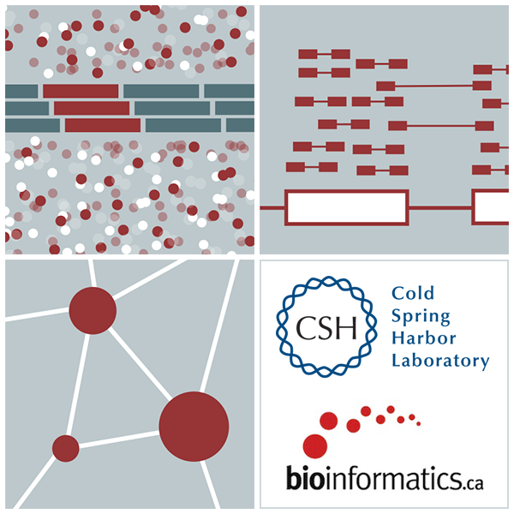
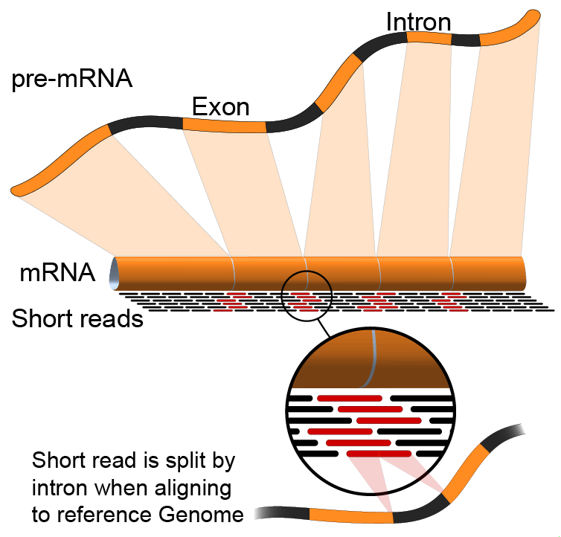

Introduction to bulk DNA/RNA sequencing
Kelsy Cotto, Malachi Griffith, Obi Griffith, Charles Hayfron-Benjamin, Evelyn Schmidt, Kartik Singhal, Zach Skidmore
CRI Bioinformatics Workshop. Apr 27-May 2, 2024

Slide 2
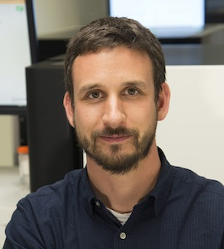
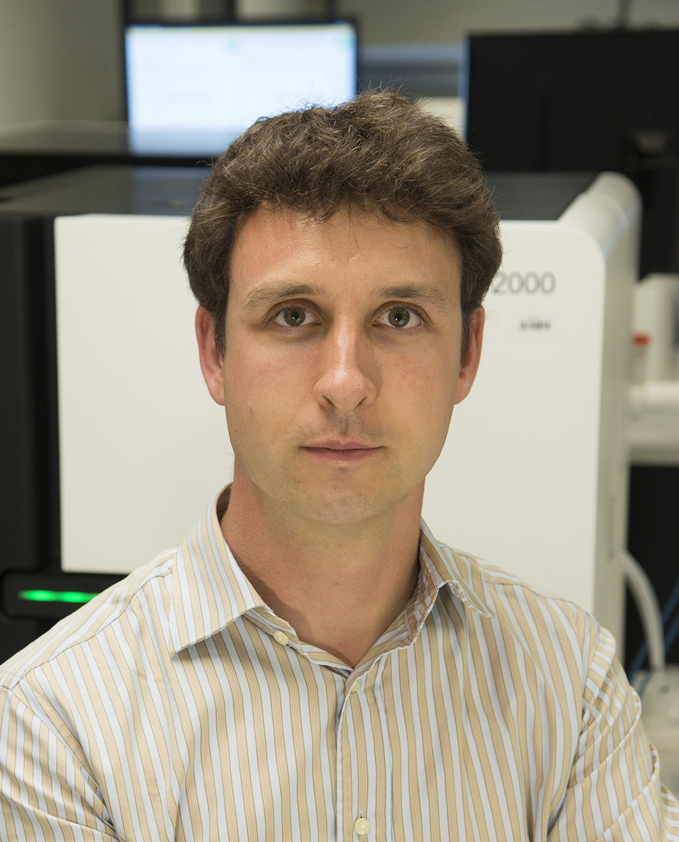

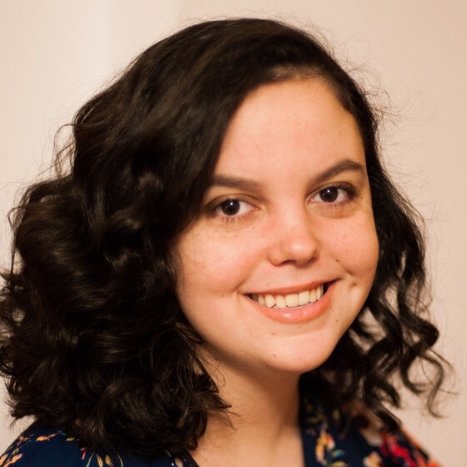
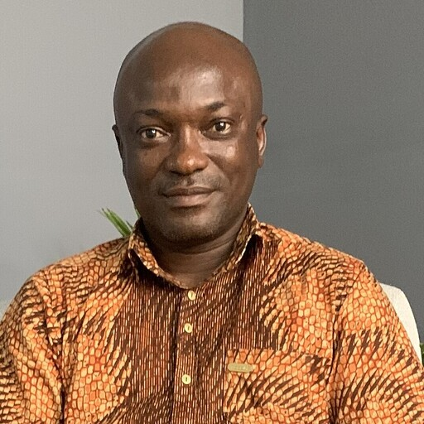
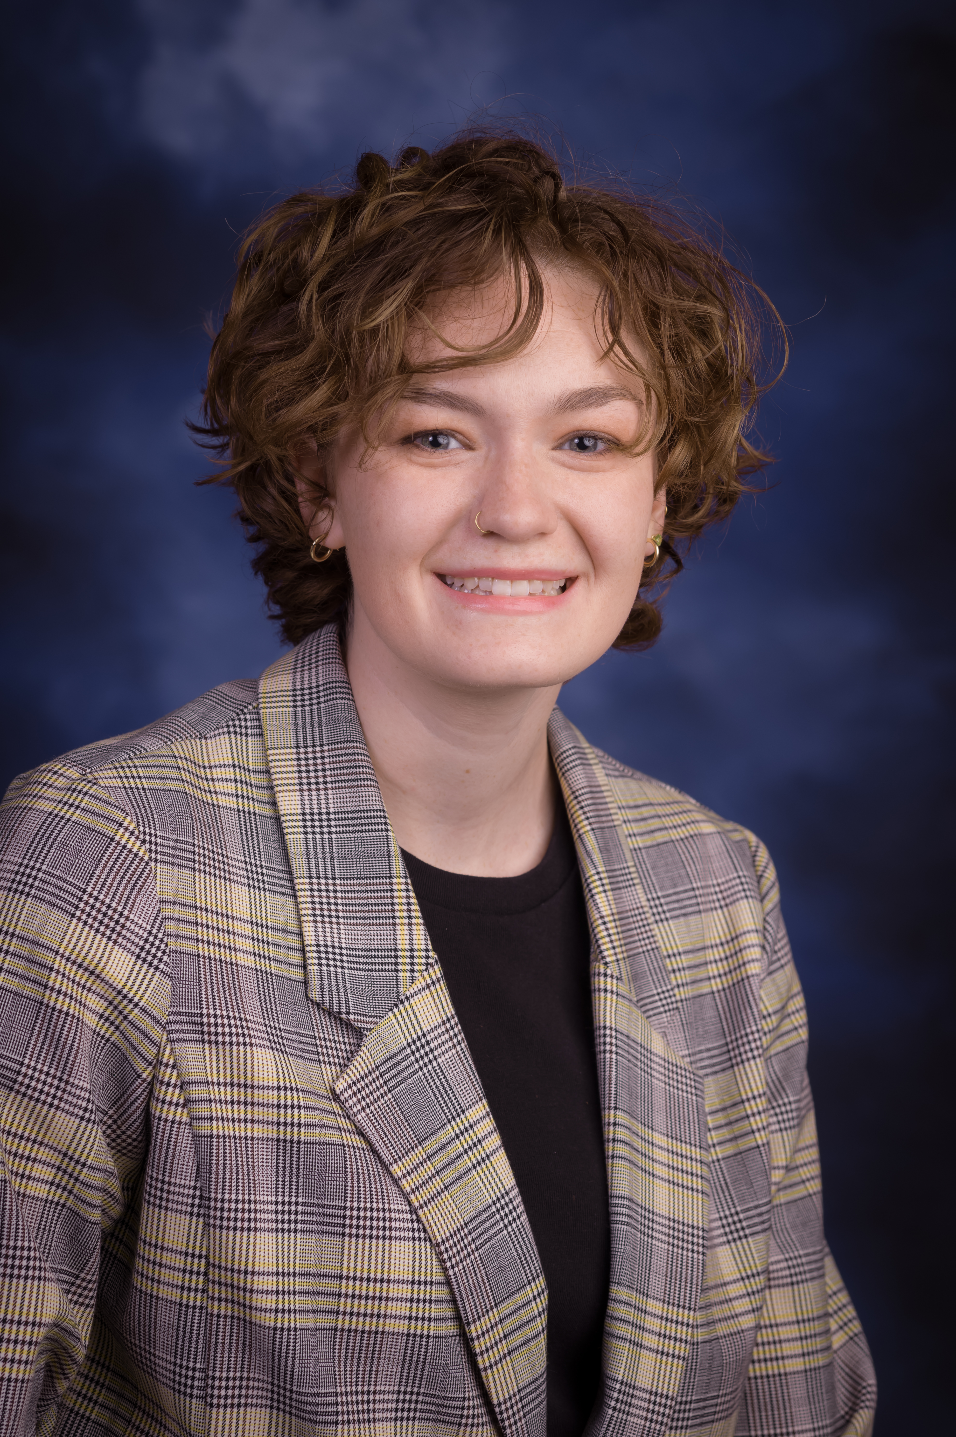
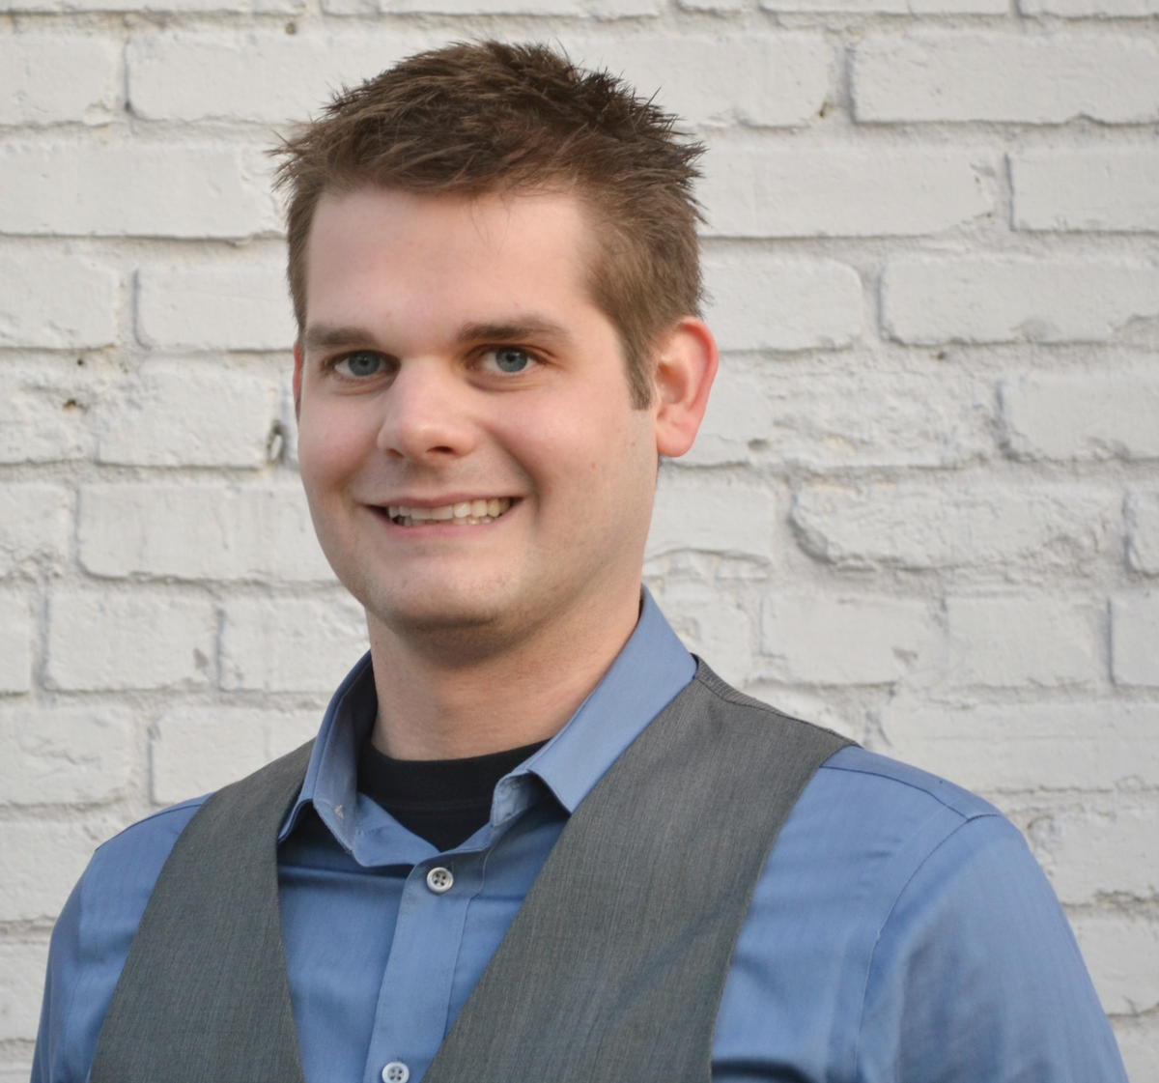
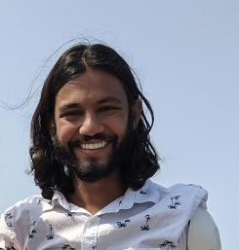
Introductions to Bioinformatics instructors (WashU team)
griffithlab.org
rnabio.org genviz.org pmbio.org
Malachi Griffith Associate Professor of Medicine Associate Professor of Genetics
Assistant Director, MGI
Obi Griffith
Associate Professor of Medicine Associate Professor of Genetics
Assistant Director, MGI
Kelsy Cotto
Staff Scientist
Charles Hayfron-Benjamin Visiting Scholar
Evelyn Schmidt
Analyst
Zach Skidmore
Staff Scientist
Kartik Singhal
Graduate Student

Slide 3
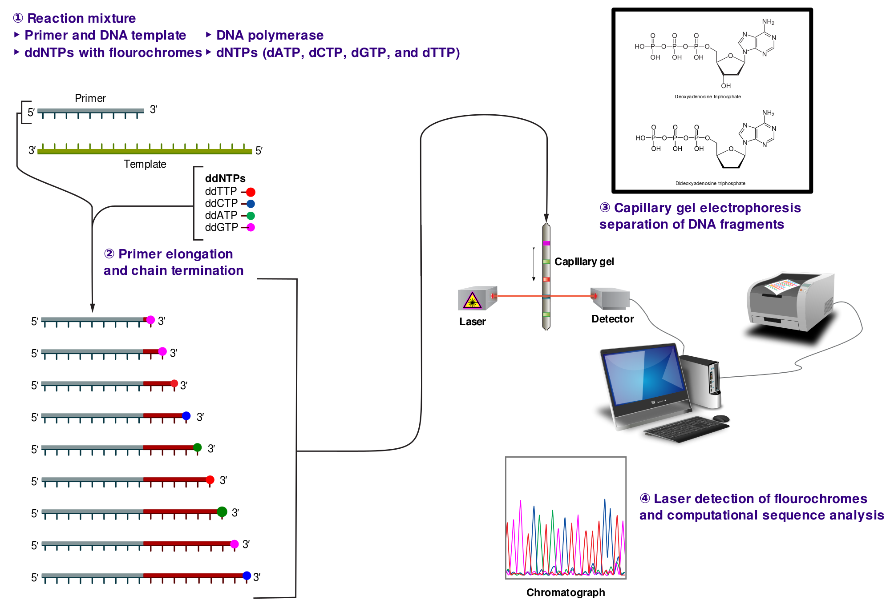
DNA/RNA analysis began with (Sanger) sequencing
Notes:
ddNTP = dideoxy nucleoside triphosphate
dNTP = deoxy nucleoside triphosphate
The incorporation of ddNTPs is used to terminate the synthesis of a growing DNA strand, resulting in partially replicated DNA fragments.

Slide 4
DNA/RNA analysis began with (Sanger) sequencing
Notes:
ddNTP = dideoxy nucleoside triphosphate
dNTP = deoxy nucleoside triphosphate
The incorporation of ddNTPs is used to terminate the synthesis of a growing DNA strand, resulting in partially replicated DNA fragments.

Slide 5
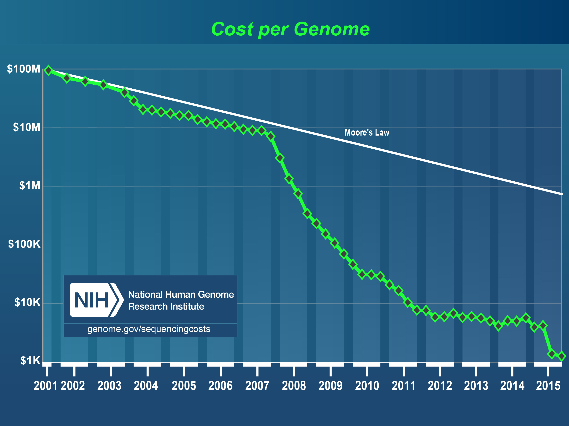
Costs of sequencing have plummeted from ~$100M to ~$1000 per human genome

Slide 6
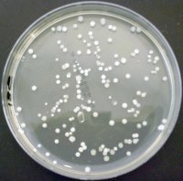
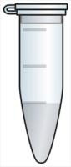
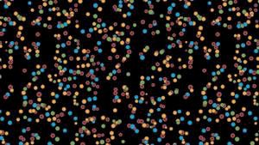
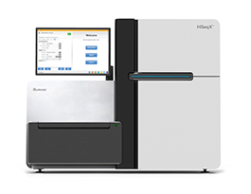
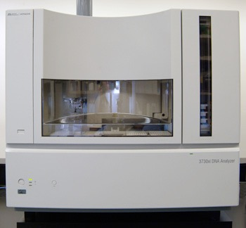
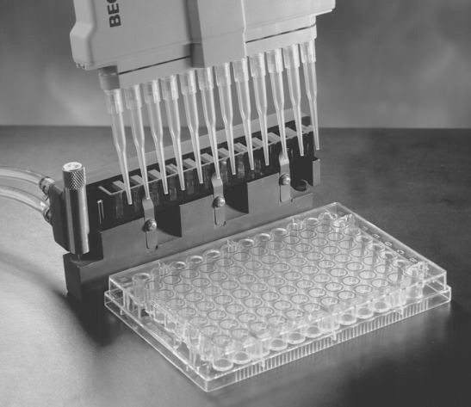
What changed? Level of parallelism
First Generation:
Second/next Generation:
Fragment DNA
Fragment DNA
Clone DNA
Add adaptors
Plasmid
Add sample directly
to sequencer
bacterial colonies
isolate 96 clones
add to sequencer
3 billion “clusters” in
a 4 x 1 inch flow-cell
Illumina HiSeq X
ABI 3700
96 well plate
Notes:
Output: 96 reads, each ~500 bp long = 1.6 x 10⁻⁵ human genomes per run
Vs
Output: 3 billion reads, each ~150 bp long = 150 human genomes per run

Slide 7
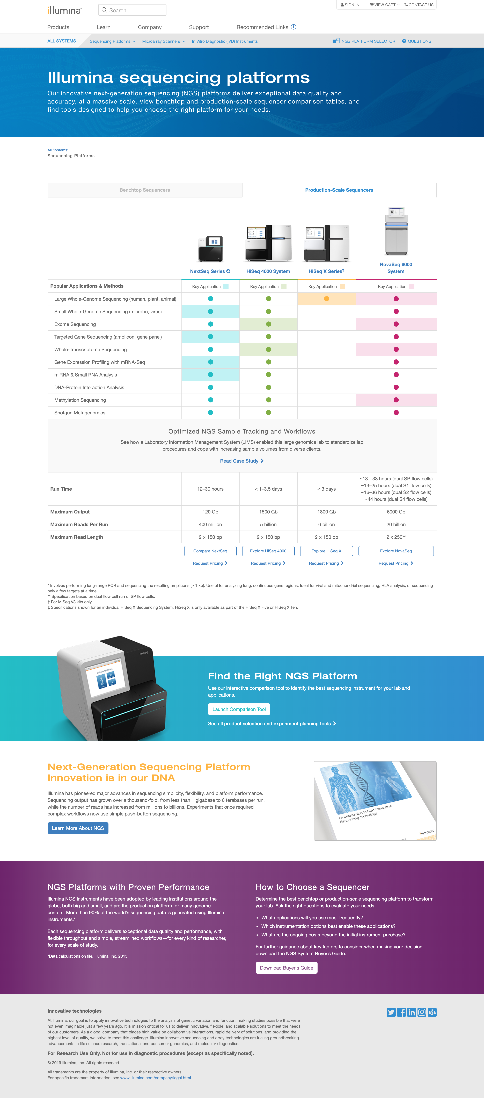
MPS (NGS) Platforms: Illumina is currently dominant
Higher accuracy, range of capacity and throughput
Longer read lengths on some platforms

Slide 8
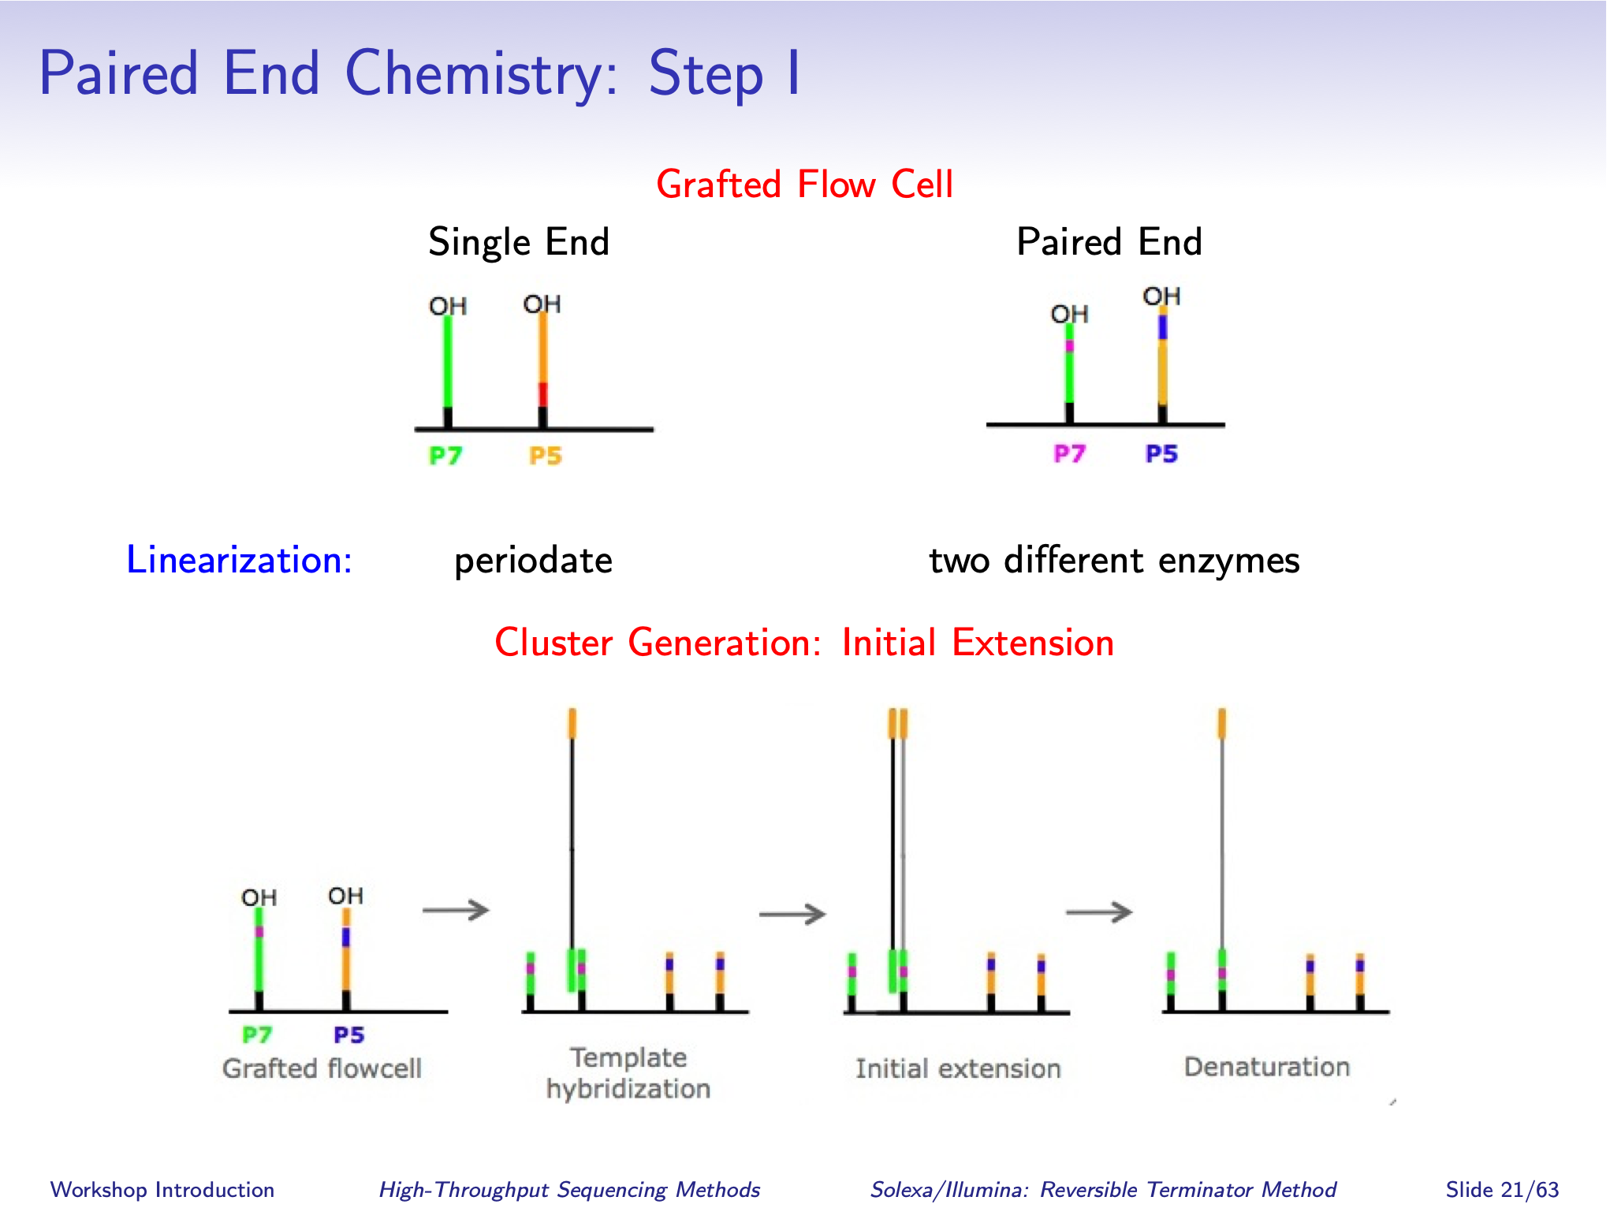
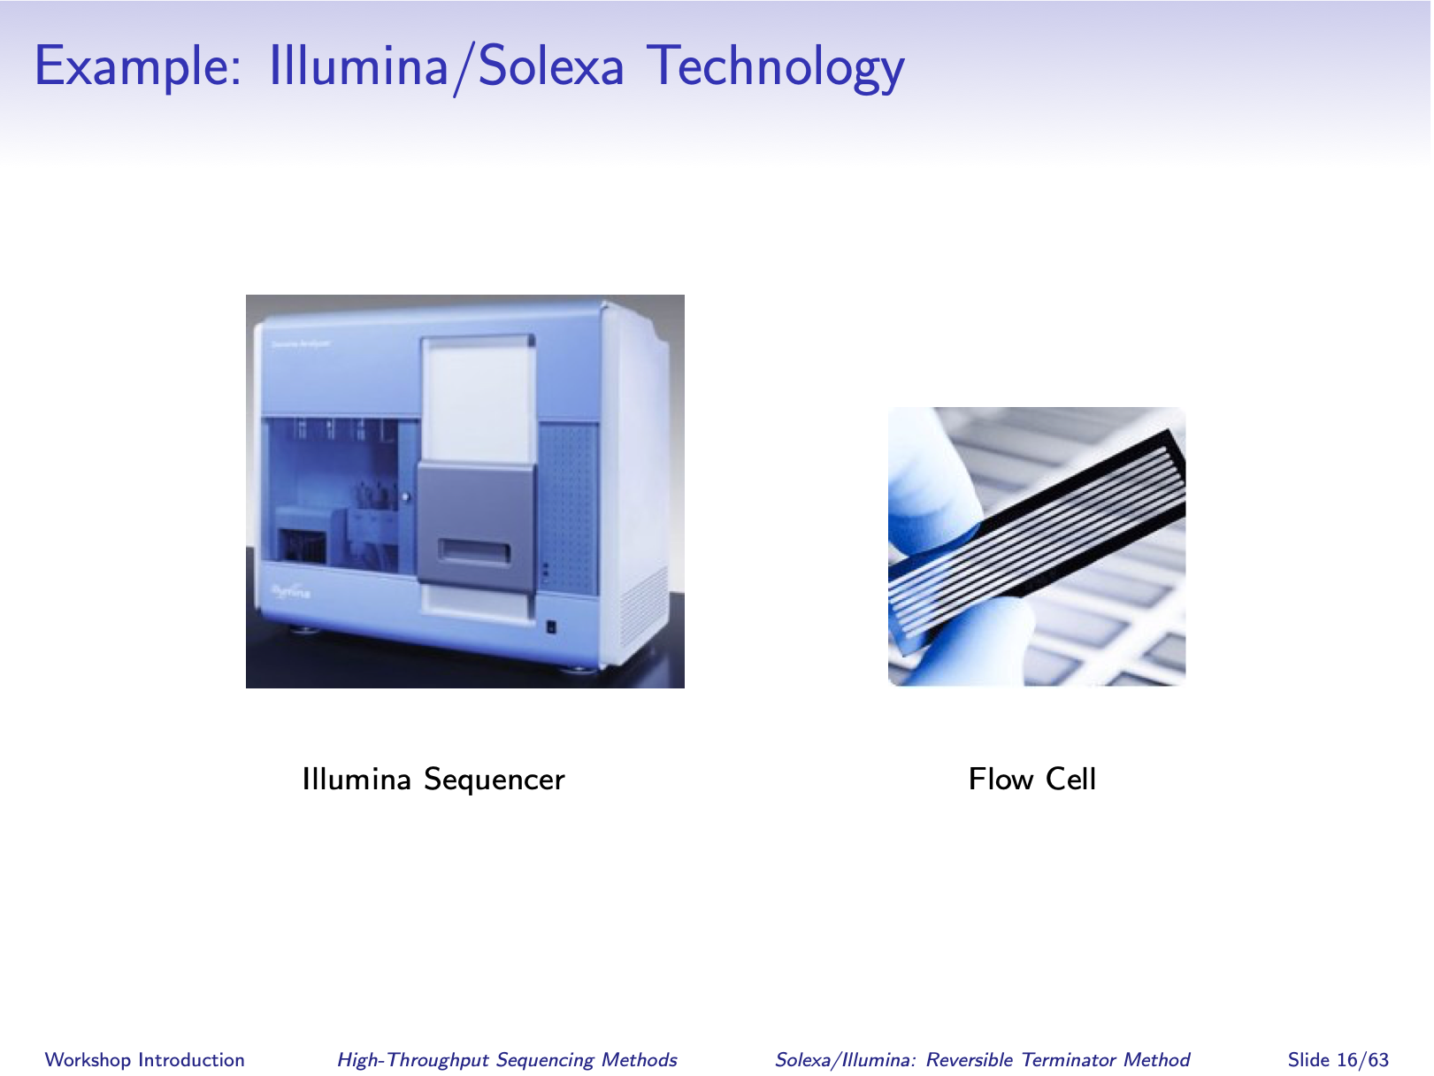
Illumina sequencing trick #1: immobilizing single molecules on a solid surface
1) Prepare Sequencing Library
Fragment DNA
Add adaptors,
size select, PCR
denature
2) Seed Flow Cell with Single Molecules
Load flow cell
Flow cell surface w/ attached primers
Template
Hybridization
Initial Extension
Denaturation

Slide 9
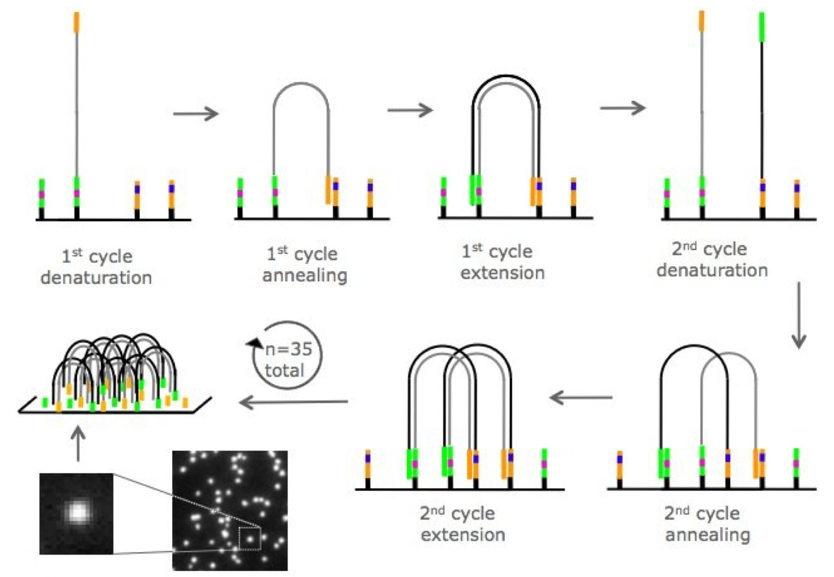
Illumina sequencing trick #2: cluster amplification by solid-phase “bridge” PCR

Slide 10
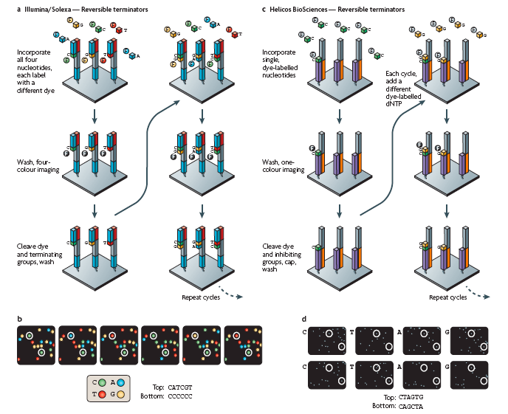
Illumina sequencing trick #3: base-by-base DNA synthesis with 4 dyes & reversible terminators
4 images merged
6 cycles w/ base-calling

Slide 11
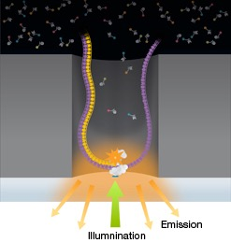
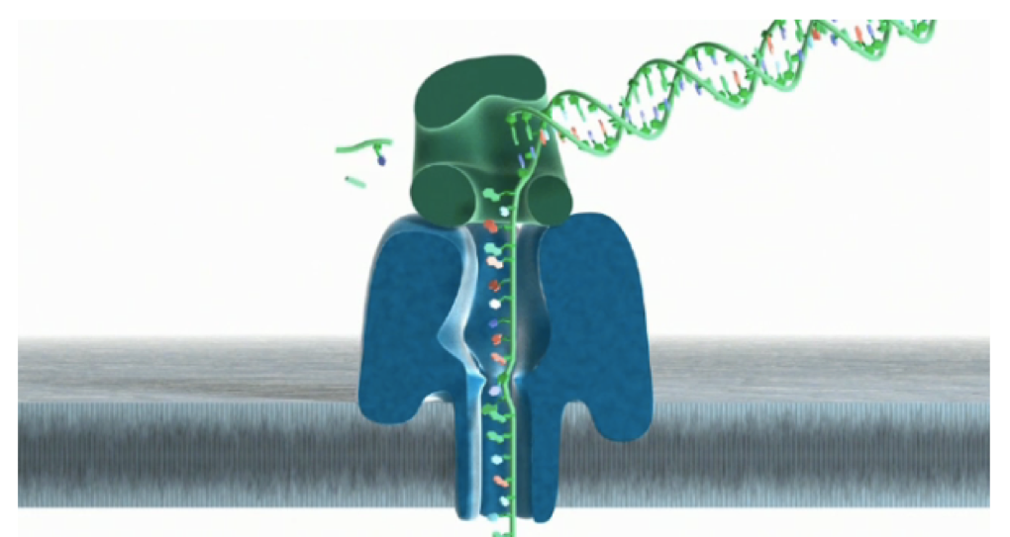
Next-next (3rd) generation sequencing platforms
Defining Characteristics: Long reads (10-100 kb) from single molecules.
Pacific Biosciences: watching a polymerase synthesize DNA in real time
Oxford Nanopore: Translocating DNA through a nanopore with electrode-based detection
The promise: Long reads will allow us to accurately sequence and assemble whole human genomes, from scratch, without using the reference genome.
Status: Currently limited by low throughput, high error rate (10-15%) and high cost (>$50,000 per human genome). 3rd generation technologies have proven useful, but generally for niche applications so far.
Notes:
PacBio: Zeromode waveguide (ZMW) well with a polymerase immobilized in the bottom binds to special hairpin adaptors. As DNA synthesis occurs each fluorescently labeled nucleotide emits light to allow real time sequencing.

Slide 12
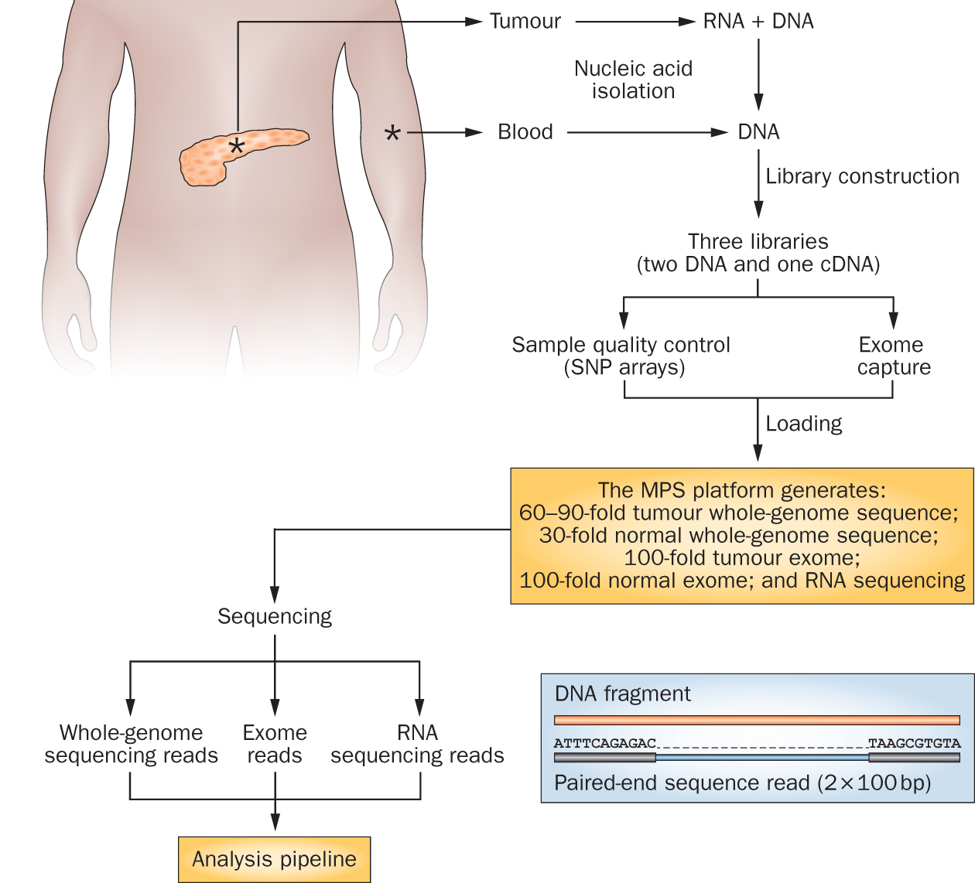
Cancer genomics research has exploded with the rapid advances in DNA sequencing technologies

Slide 13
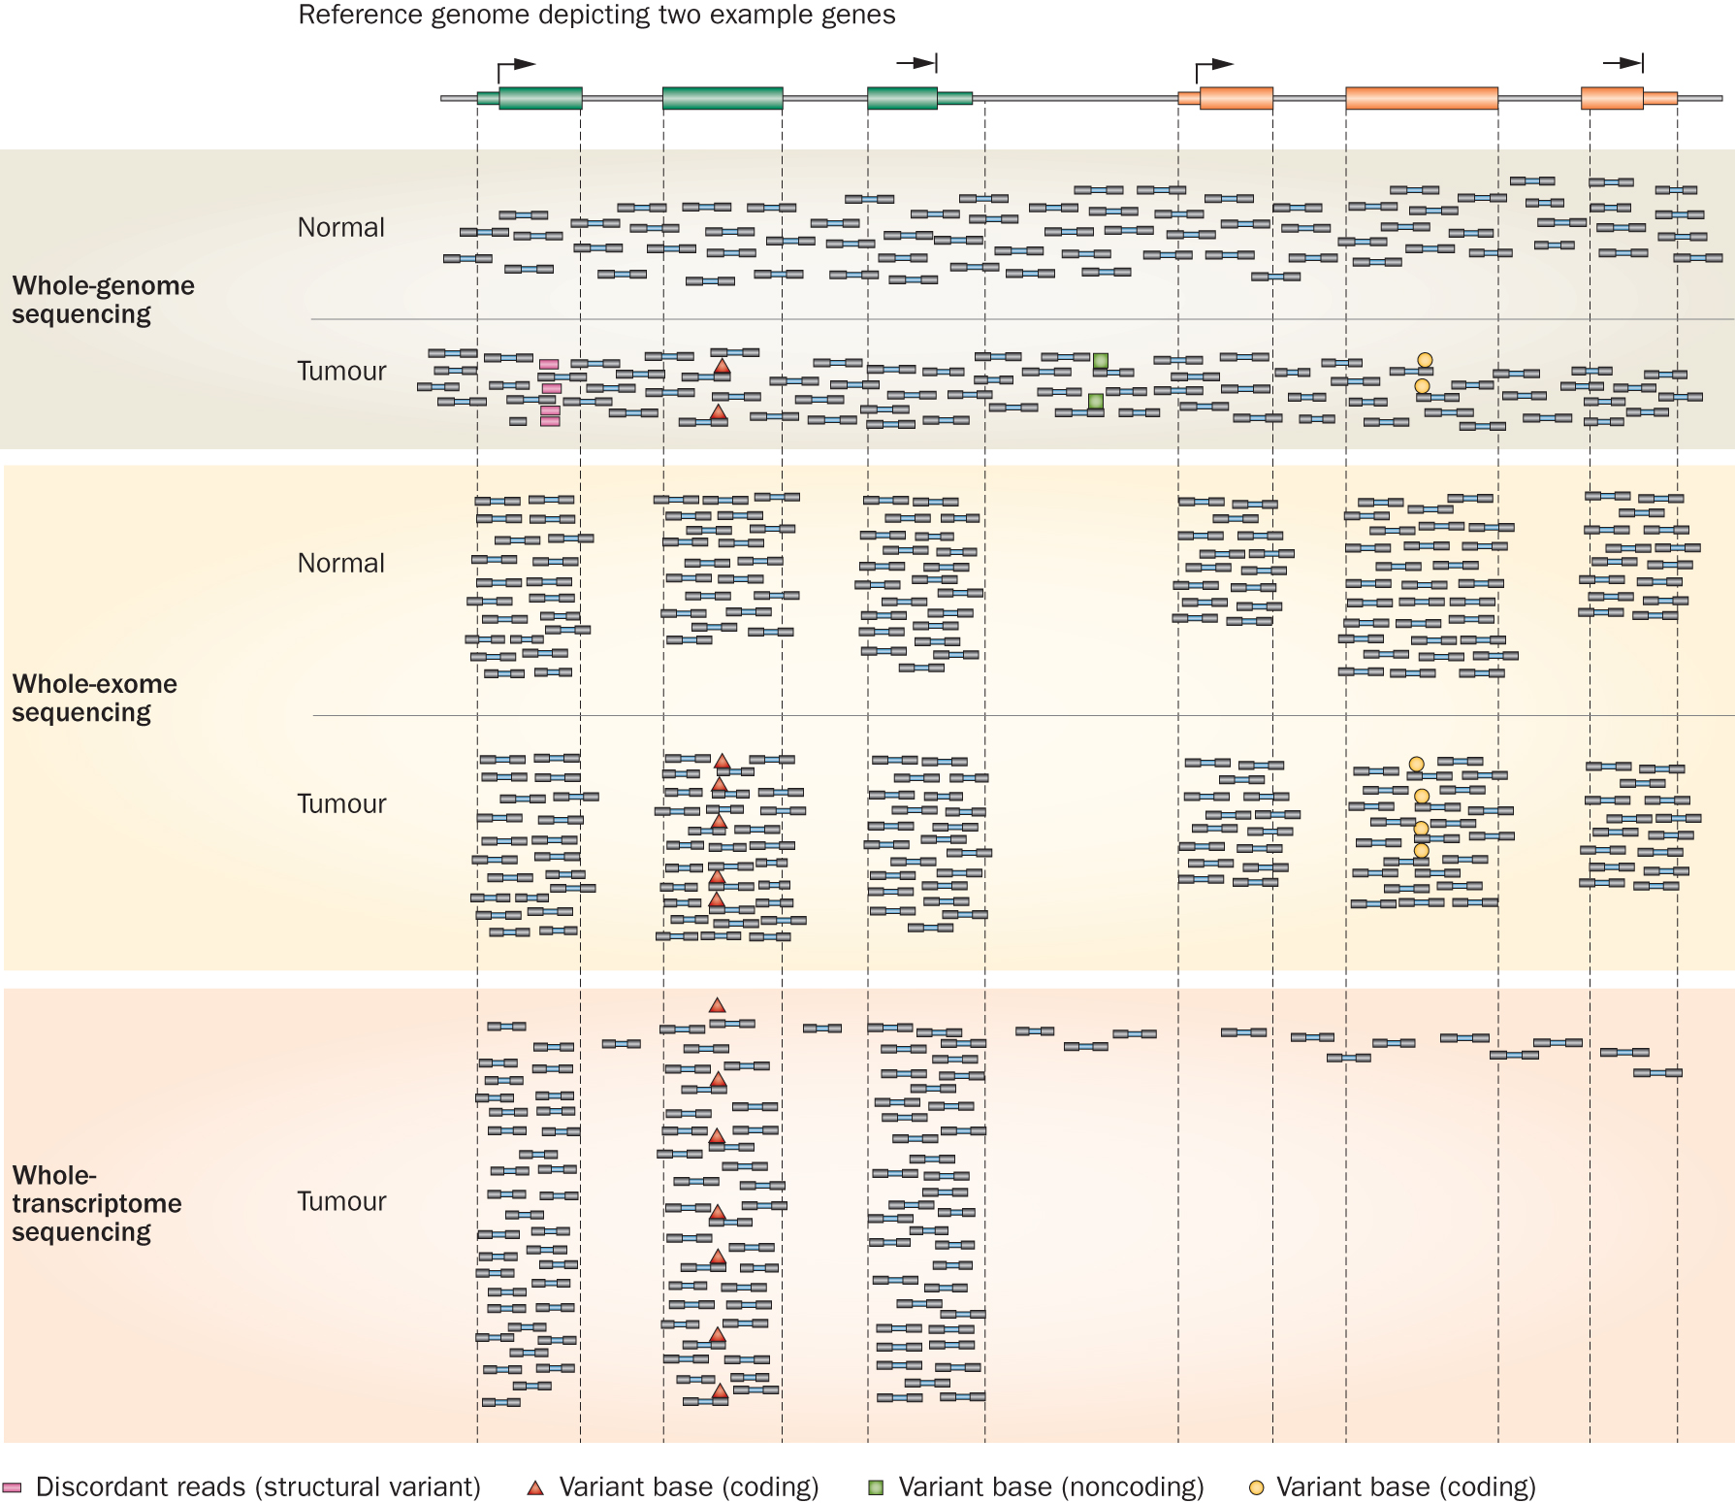
Whole genome, exome and transcriptome allow us to detect and confirm many molecular alteration types
‘WGS’
‘Exome’
‘RNA-seq’
Notes:
Each of these three data types, whole genome, exome and transcriptome, brings something to the table.
Whole genome gives you broad, even, and relatively unbiased coverage across the genome.
Exome gives you more focused coverage but much greater depth over the exons for a much lower cost than whole genome
RNA-seq gives you a snapshot of the transcriptome.

Slide 14
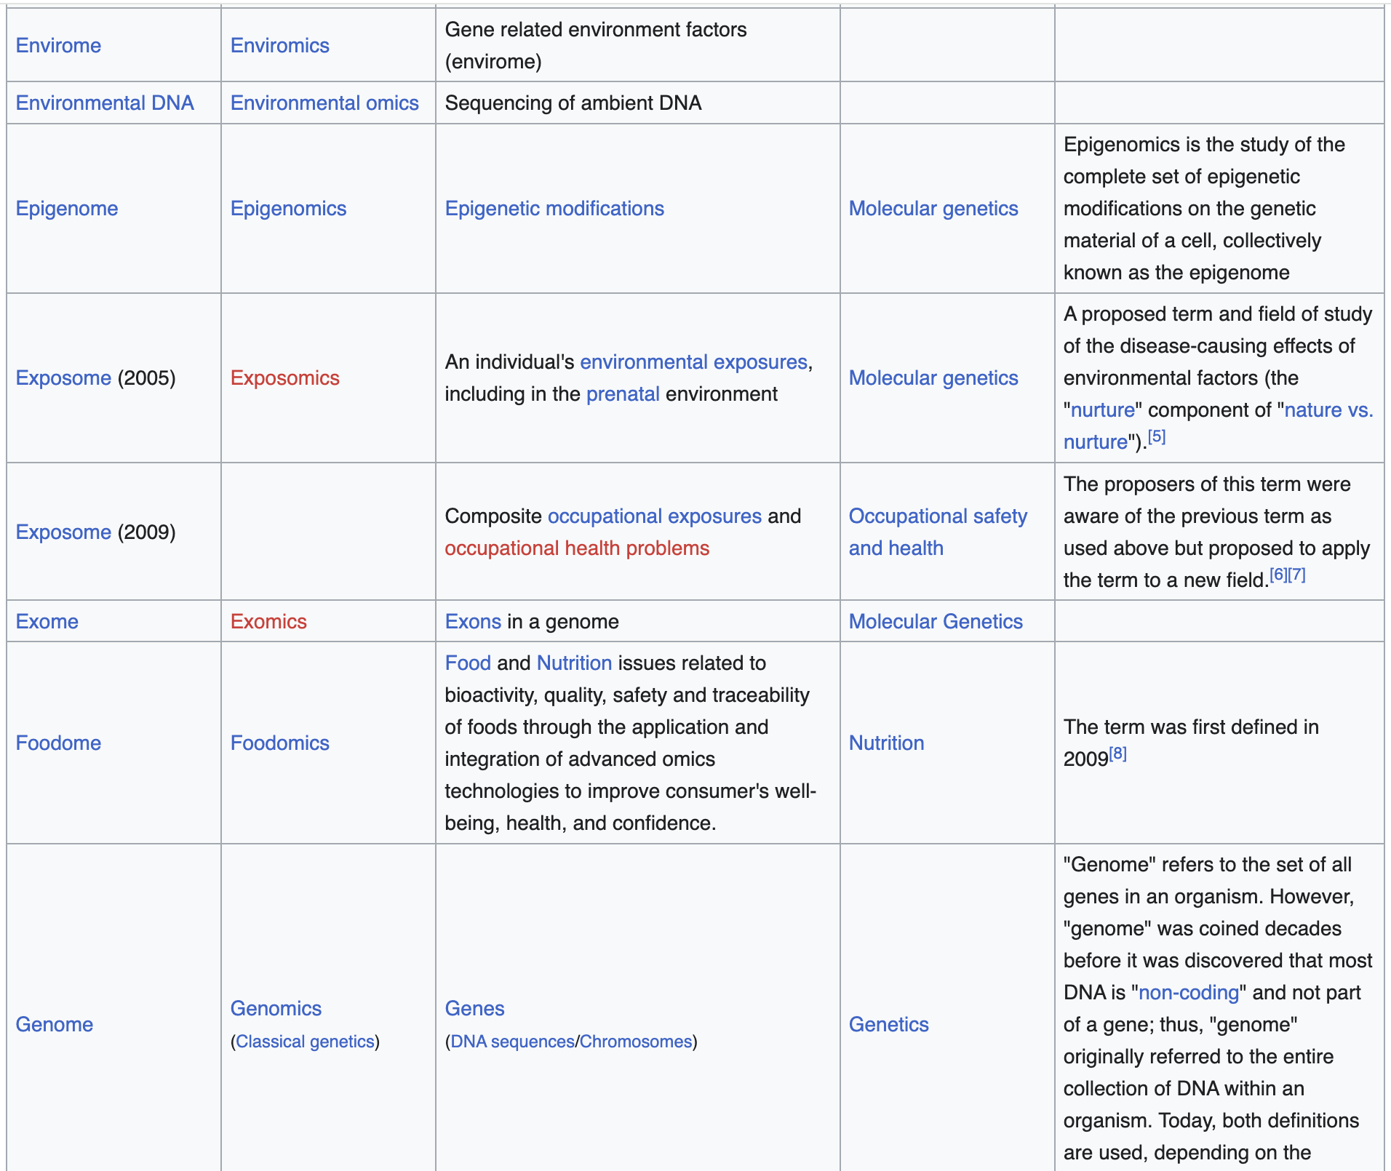
Many other omic approaches exist
Nearly 50 “omics” topics in biology defined:
https://en.wikipedia.org/wiki/List_of_omics_topics_in_biology
Notes:
https://en.wikipedia.org/wiki/List_of_omics_topics_in_biology

Slide 15
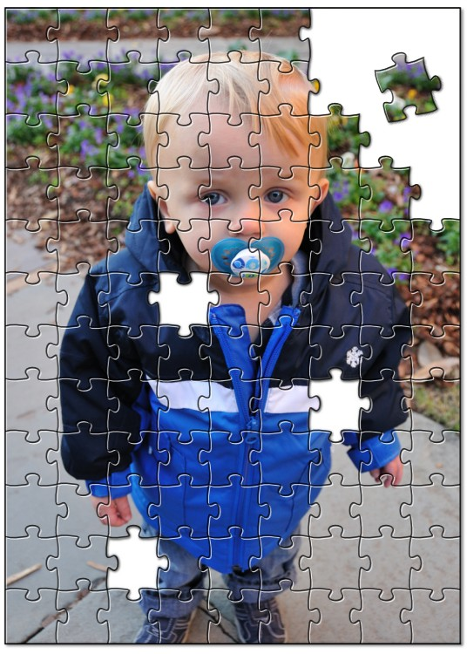
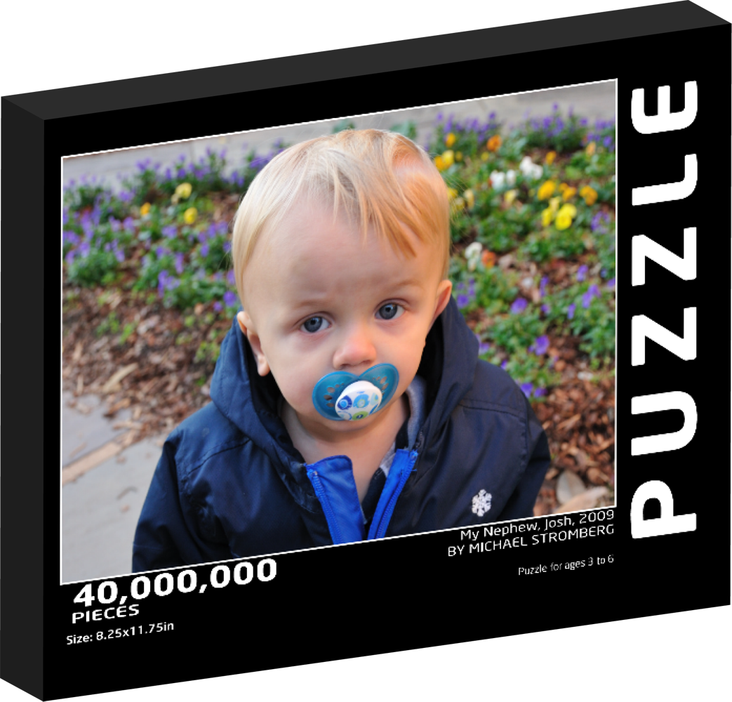
How does it work? Short read alignments are the currency of DNA/RNA analysis
Alignment is about fitting individual pieces (reads) into the correct part of the puzzle
The human genome project gave us the picture on the box cover (the reference genome)
Imperfections in how the pieces fit can indicate damage or variation in picture
AGCCTGAGACCGTAAAAAAGTCAAG
|||||||||||||||||
GAGACCGTAAAAACGTC
Reference:
A read sequence:
A variant

Slide 16
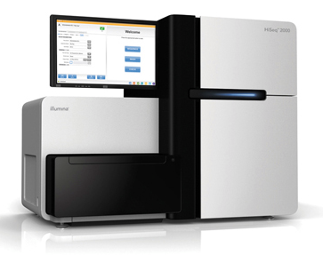
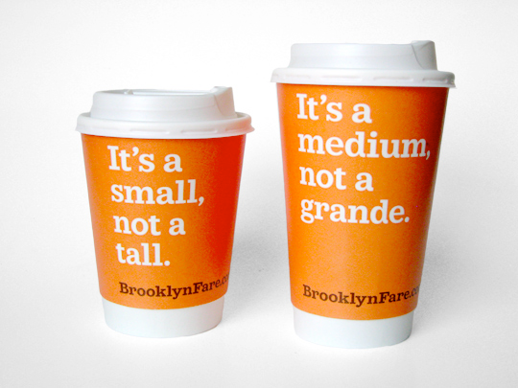

Alignment is central to most genomics research
Find peaks
Align
to
genome
Quantify transcripts
FASTQ
format
Quality control
Find SVs
Analysis,
Interpretation,
Discovery
.
.
.
etc.
Phase 0
Phase1
Phase 2-100
Slide courtesy of Andrew Farrell, Obi and Malachi Griffith

Slide 17
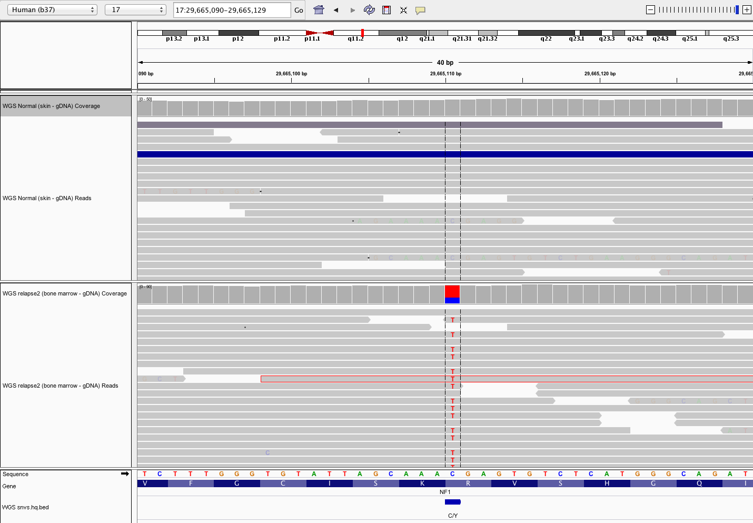
Single nucleotide variants (SNVs) and insertions/deletions (indels) appear as short alignment discrepancies from reference genome
Normal
Single read
Tumor
Variant supporting read
Amino acid
Reference sequence
Notes:
This example SNV was detected in an ALL case
This is the simplest type of genomic event to detect, describe, annotate. Of course in this case the frequency is close to 50%. Suggesting a heterozygous mutation present in 100% of the tumor cells. If the tumor is impure, or heterogeneous, possibly with multiple sub-clones, or the normal is contaminated with tumor cells, calling even this simplest type of variants gets much harder.
We currently use four somatic SNV variant callers: SomaticSniper+Samtools, VarScan, Strelka, and Mutect

Slide 18
Variant allele fraction (VAF) and coverage
VAF = Variant reads / Total reads
Coverage track
Normal
VAF = 0/20 = 0%
Tumor
VAF = 14/20 = 70%
Total coverage=20X
Recall that we have two copies of our genome (2n). Mutations are typically in one copy. A heterozygous variant (one copy) is expected to have VAF = 50%. Often not true due to sample purity, tumor heterogeneity, sampling error, alignment issues, copy number variation, etc.

Slide 19
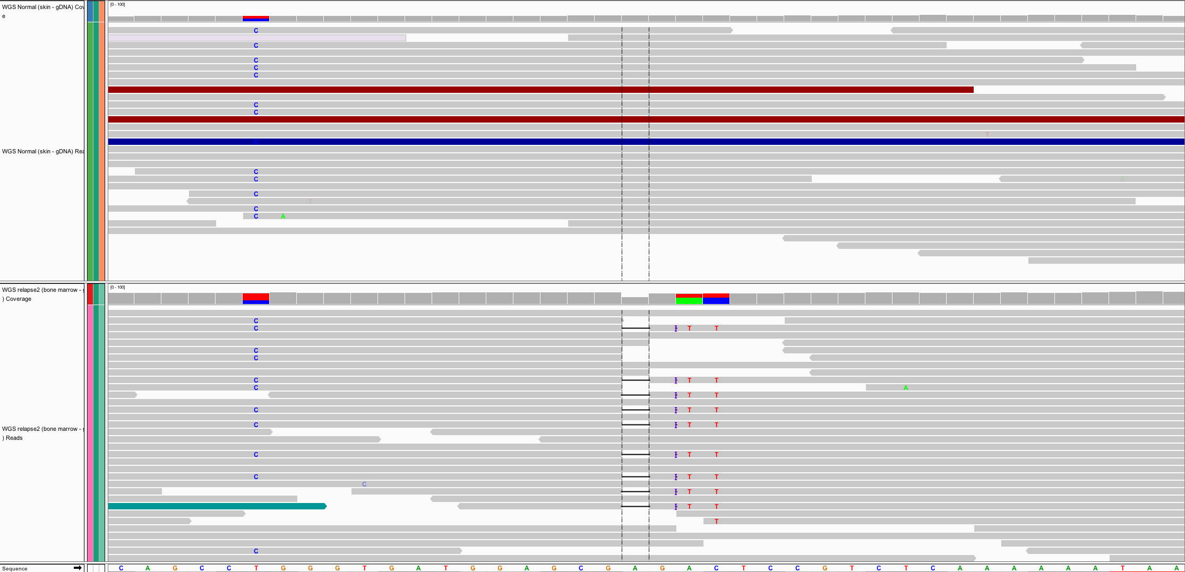
Both somatic and germline mutations are important
Germline mutations
Present in egg or sperm
All cells of affected offspring
Heritable
Cause of familial cancers
Somatic mutations
Occur in non-germline tissues
Only tumor cells
Non-heritable
Cause of sporadic cancers
Normal
Tumor
Germline
Somatic

Slide 20
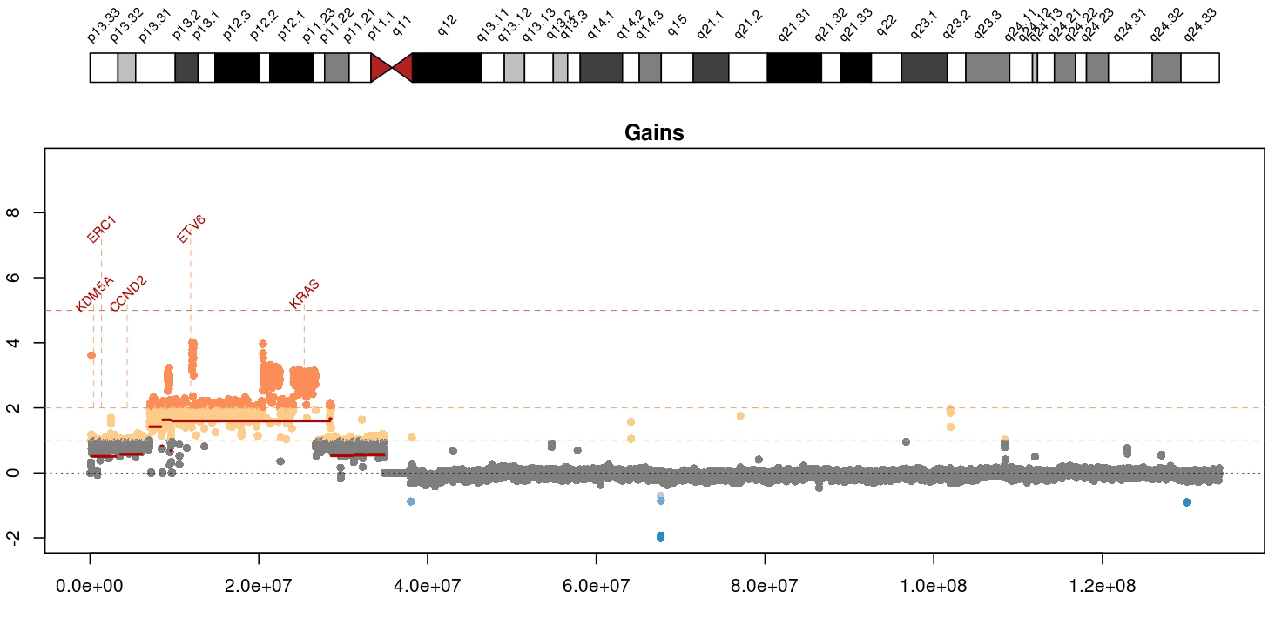
Copy number variants (CNVs) appear as deviations from in alignment “depth” or “coverage”
Mean tumor-normal depth per 10kb window plotted
Notes:
Whole genome data is exceptionally good a detecting copy number alterations in tumors. You essentially get a beautiful digital karyotype for each tumor. Here we see a complex amplification affecting KRAS and ETV6 and other critical cancer genes by both single copy and two copy gains.
We currently use cnv-hmm, CopyCat, and CnView for this kind of copy number analysis

Slide 21
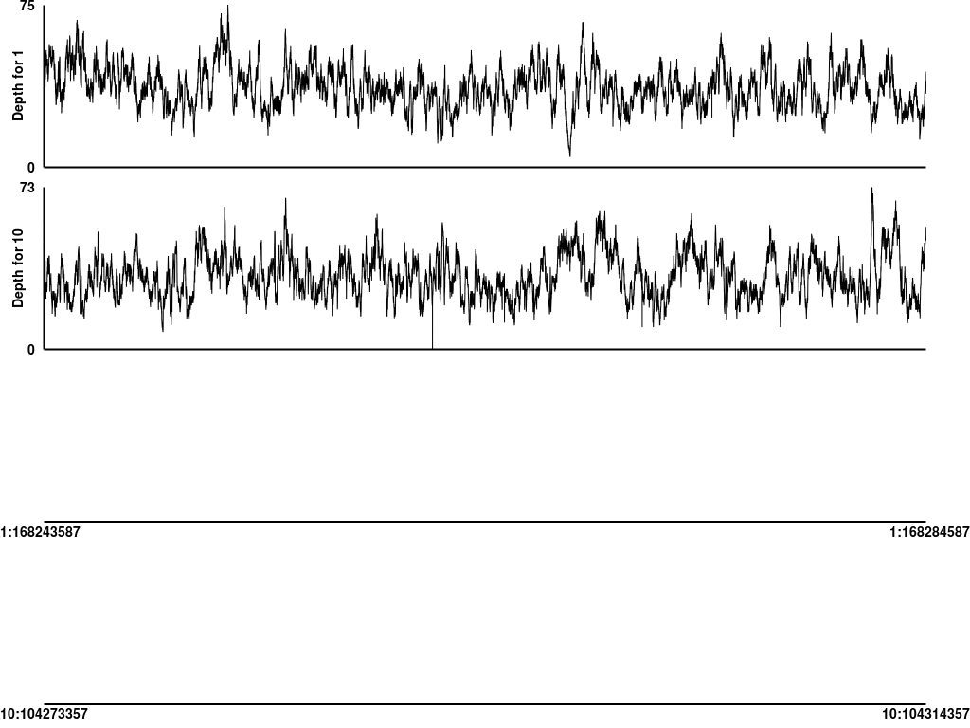
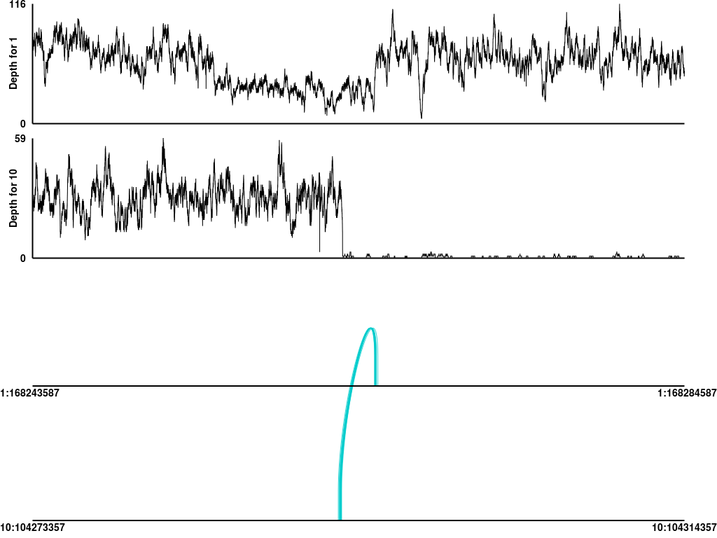
Structural variants (SVs) can be identified using a combination of coverage and discordant read alignments
Normal
Tumor
Coverage
Coverage
Chr1
Chr10
Chr1
Chr10
Discordant read support
Discordant read support
A Chr1-Chr10 (TBX19-SUFU) unbalanced translocation identified in an adult acute lymphocytic leukemia.
Notes:
Detected in an ALL case. One of the more difficult even types to predict are structural variants such as the interchromosomal translocation show here. Discordant read pairs, coverage patterns, and reads aligning across a junction breakpoint supporting a translocation involving chr1 and chr10 in this tumor. It is clearly somatic and not observed in the normal. While we can identify such events readily they are generally buried in a large pile of false positives. We also fear a large number of false negatives (but we have difficulty estimating this).
We currently use a combination of BreakDancer, SquareDancer, and Tigra-SV in our SV pipeline. We are in the process of incorporating lumpy-sv.

Slide 22
Expressed gene fusions can be identified by discordant read alignments spanning known exons from RNA-seq data
EP300-ZNF384
Encompassing (70)
RNA-seq read support
Spanning (258)
7
8
7
7
7
7
8
7
6
5
8
7
8
7
6
7
8
6
5
9
ZNF384 (NM_133476.4)
EP300 (NM_001429.3)
Slide from Chris Maher and Jin Zhang
12p13.31
22q13.2
Exons 1-8 of EP300 fused to exons 7-10 of ZNF384 in head-to-tail fashion.
Notes:
Here we have an expressed gene fusion detected by RNA-seq detected in an ALL case.
These events are detected by mining RNA-seq alignments for cases where both encompassing (or discordant) read pairs and fusion junction spanning reads support a geneA to geneB fusion.
As with detecting structural variants in the DNA data we know that overall we are not doing a great job of identifying these things. The current state of software packages for these events leaves a lot to be desired. We use ChimeraScan and Integrate. But we have also evaluated tophat-fusion, defuse, and others.

Slide 23
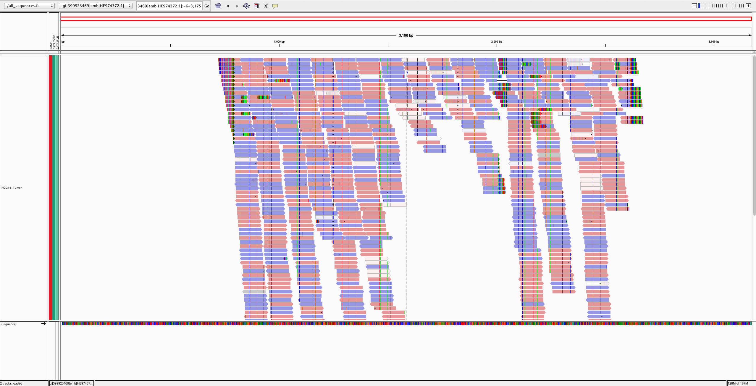
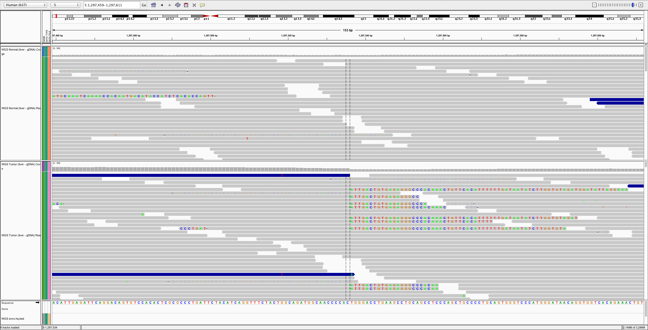
Viral expression and integrations can be identified by competitive alignment with human and viral genome databases
Many reads align directly to viral genome (Hepatitis B)
Soft-clipped reads in human reference help identify integration site
Example from HCC case thought to be virus negative
Notes:
In this example, we profiled 30 liver cancers that were collected as part of a set that were cirrhosis negative and hepatitis negative (i.e. lacked the usual risk factors for HCC). Despite this clinical assessment, in one case we detected integration of HCV (hepatitis C virus) by WGS.

Slide 24
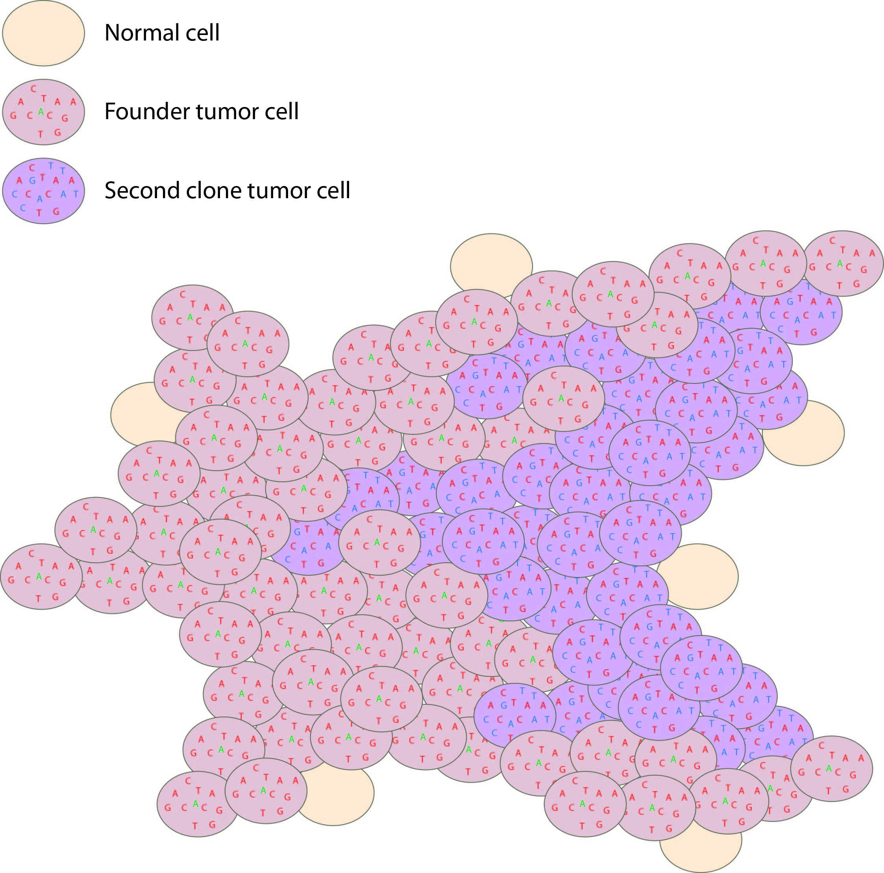
Tumor clonal architecture can be inferred from distributions of VAFs
Tumor variant allele frequency
Proportion
NF1
Read coverage (X)
WGS data
Tumor variant allele frequency
Tumor variant allele frequency
Notes:
While not a specific event, we are increasingly looking at clonal heterogeneity as a distinct feature of several tumor types. In this ALL example, by examining the whole genome data we detected a dominant clone and a distinct sub-clone that evolved from it and represented ~40% of the tumor cell population.
We have encountered some striking examples where upon treatment, only the sub-clone was affected (representing a temporary debulking of tumor with no chance of a complete cure). We also see striking examples where a sub-clone as rare as ~2% of cells in the primary tumor escapes treatment and dominates 100% of the tumor in relapse. Based on both of these scenarios we are convinced that understanding the clonal architecture of a tumor may eventually be highly relevant to clinical decisions.

Slide 25
Tumor genome analysis can reveal dozens to thousands of alterations per patient
SNVs
SVs
Indels
Gene expression
CNVs
Notes:
From an end users perspective what you get out of the GMS is summarized results and visualizations that help you interpret and mining NGS data
The following slides show some examples of each of these types of predictions. They are listed in order from most developed and reliable to least developed and most experimental

Slide 26
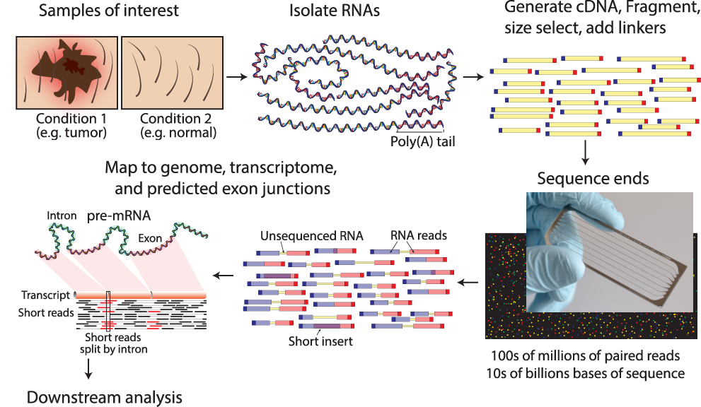
RNA sequencing
Notes:
Notes on paired end read depiction:
Each line depicts a sequenced fragment. These consist of adapters, and portions sequenced from each end
Blue is being used to indicated read 1, and red for read 2
If the fragment is long enough relative to the read sequence length, there will be a portion in the middle that is not sequenced
Read1 and Read2 can also overlap
Note the portion

Slide 27
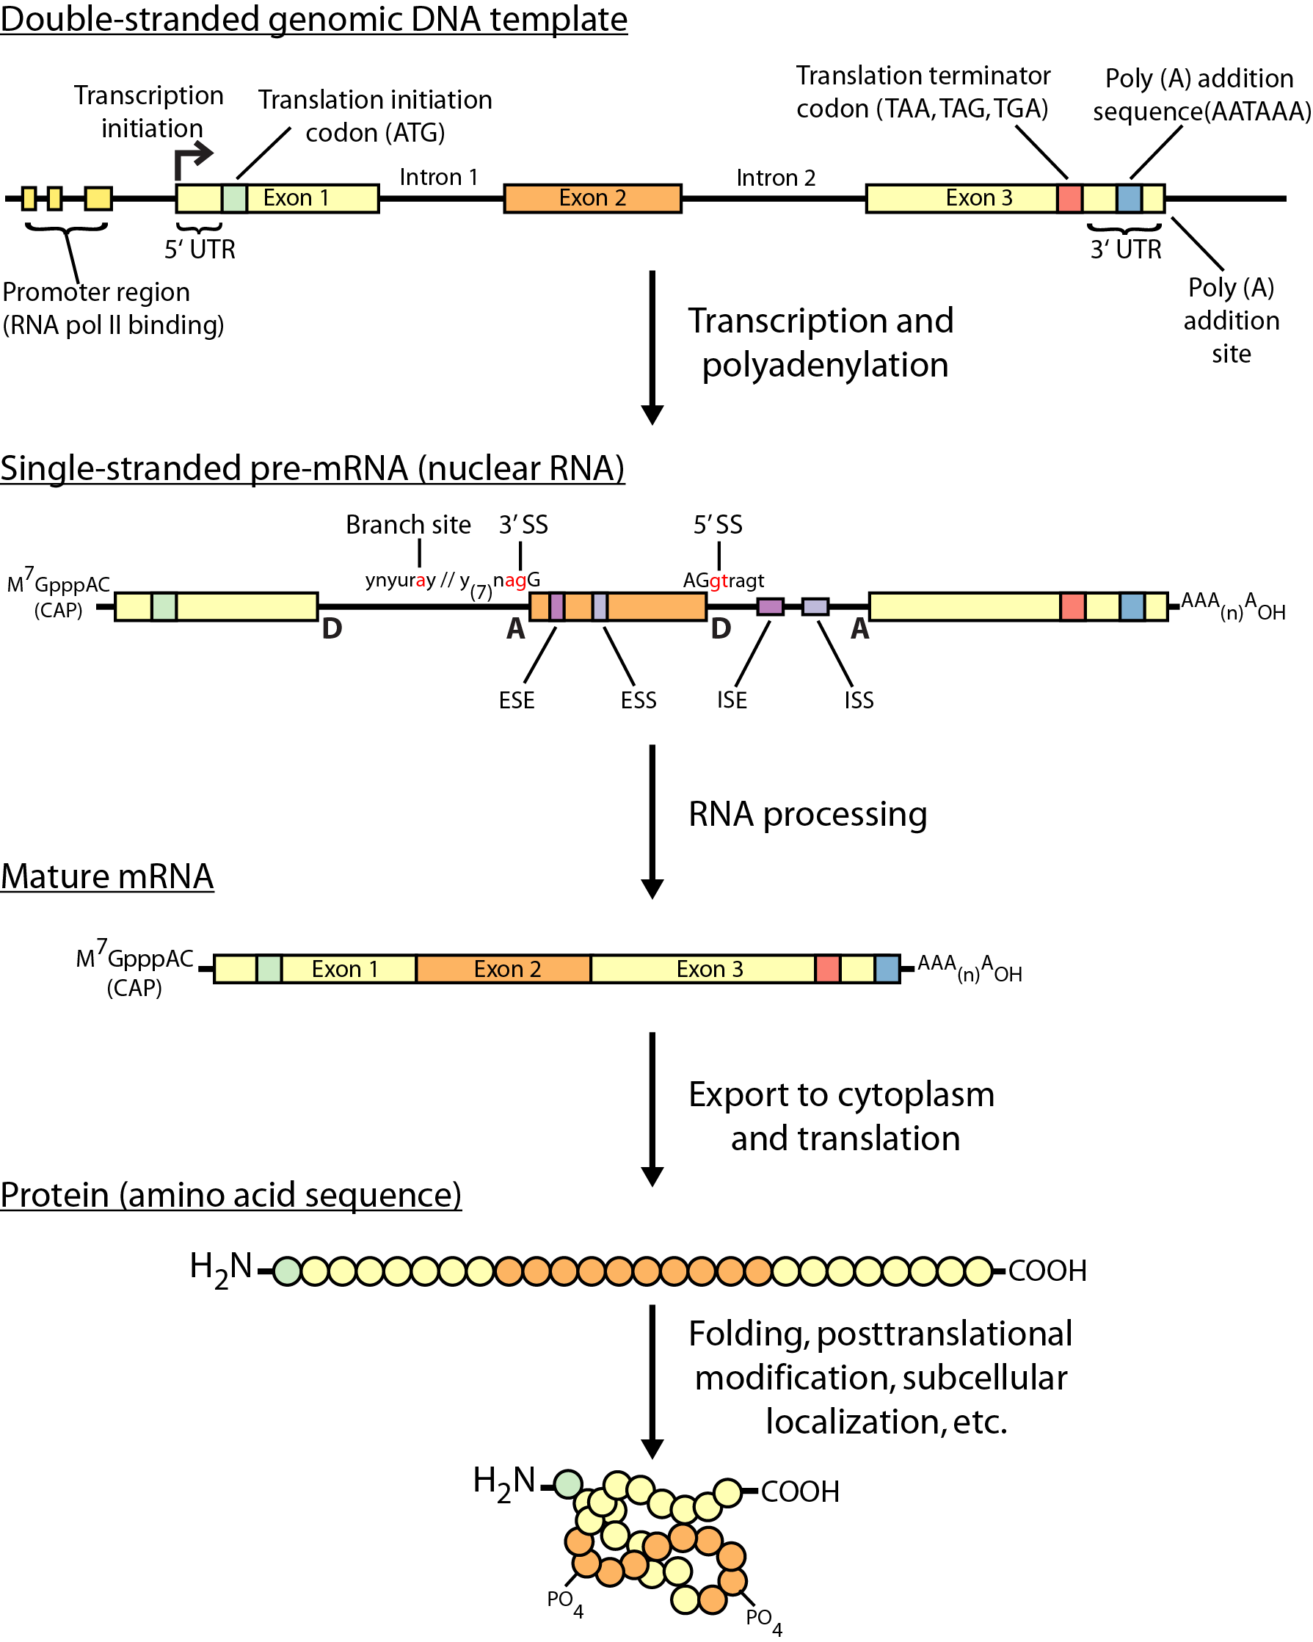
Gene expression
Thinking about the molecular biology here, what is actually being sequenced in an RNA-seq experiment?
Does it differ depending on the sequencing platform? Or for bulk vs single cell sequencing?

Slide 28
Challenges
Sample
Purity?, quantity?, quality?
RNAs consist of small exons that may be separated by large introns
Mapping reads to genome is challenging
The relative abundance of RNAs vary wildly
10⁵ – 10⁷ orders of magnitude
Since RNA sequencing works by random sampling, a small fraction of highly expressed genes may consume the majority of reads
Ribosomal and mitochondrial genes
RNAs come in a wide range of sizes
Small RNAs must be captured separately
PolyA selection of large RNAs may result in 3’ end bias
RNA is fragile compared to DNA (easily degraded)

Slide 29
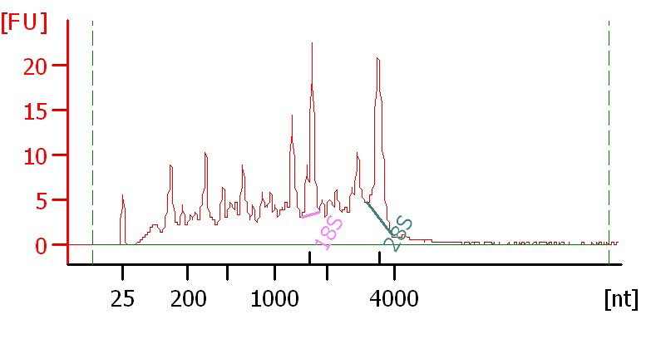
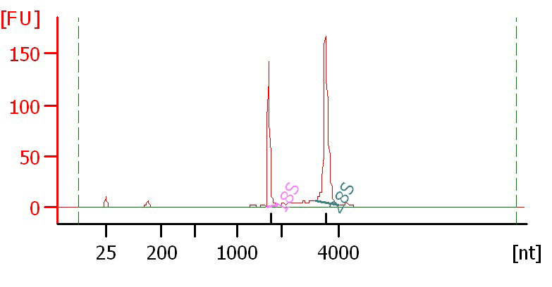
Agilent example / interpretation
https://goo.gl/uC5a3C
‘RIN’ = RNA integrity number
0 (bad) to 10 (good)
RIN = 6.0
RIN = 10

Slide 30
Design considerations
Standards, Guidelines and Best Practices for RNA-seq
The ENCODE Consortium
Download from the Course Wiki
Meta data to supply, replicates, sequencing depth, control experiments, reporting standards, etc.
https://goo.gl/6LePBW
Several additional initiatives are underway to develop standards and best practices that cover many of these concepts. These include: the Sequencing Quality Control (SEQC) consortium, the Roadmap Epigenomics Mapping Consortium (REMC), and the Beta Cell Biology Consortium (BCBC).

Slide 31
There are many RNA-seq library construction strategies
Total RNA versus polyA+ RNA?
Ribo-reduction?
Size selection (before and/or after cDNA synthesis)
Small RNAs (microRNAs) vs. large RNAs?
A narrow fragment size distribution vs. a broad one?
Linear amplification?
Stranded vs. un-stranded libraries
Exome captured vs. un-captured
Library normalization?
These details can affect analysis strategy
Especially comparisons between libraries

Slide 32
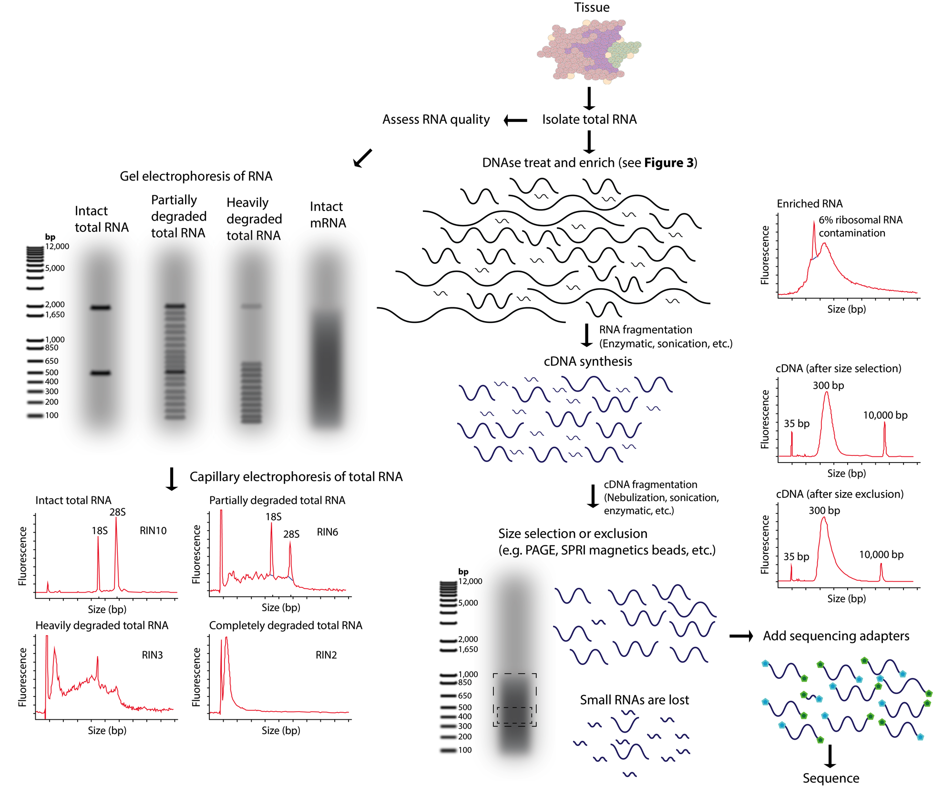
RNA-seq - Fragmentation and size selection
Notes:
- RNA-seq library construction may involve both fragmentation and size selection. These procedures may be modified according to the integrity and amount of starting total RNA. The distributions of RNA molecule sizes are depicted for input total RNA and at various stages during the process of RNA/cDNA fragmentation and size selection. Commonly used methods for fragmentation and size selection are depicted along with the expected output of a quality-control assay at each stage (in the form of a capillary electrophoresis trace). Note that in the final library, it is typical that the majority of RNAs below a certain size (typically <150–200 bp) are underrepresented. Refer to S3 Table and S7 Table for more details on many of the concepts depicted in this figure.

Slide 33
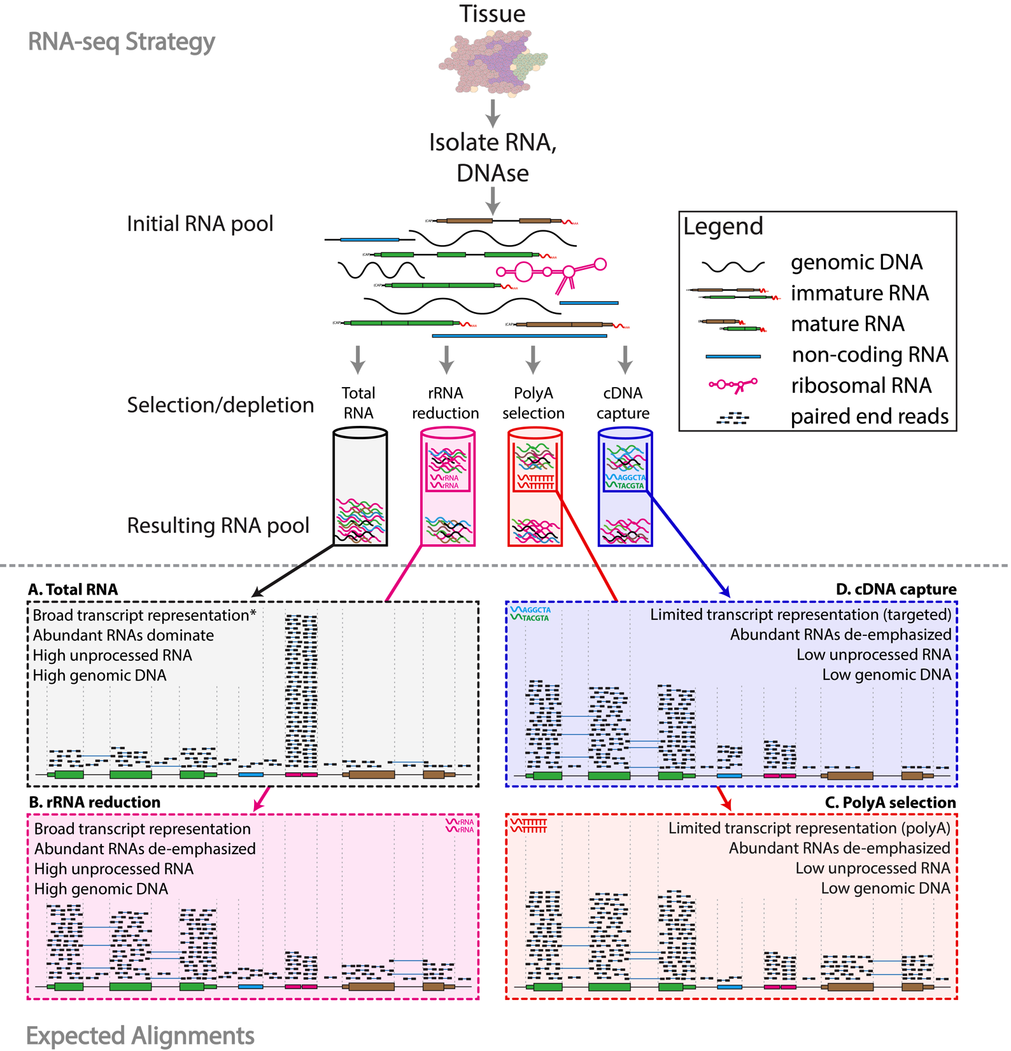
RNA-seq - sequence enrichment (selection/depletion)
Notes:
RNA-seq library enrichment strategies that influence interpretation and analysis. RNA-seq library construction protocols differ widely, and these differences have significant consequences for data interpretation and analysis. The figure above illustrates representative alignment results for either total RNA or one of three commonly used enrichment strategies at a hypothetical genomic locus with very highly expressed ribosomal RNA (pink), highly expressed protein coding (green), lowly expressed protein coding (brown) and lowly expressed noncoding RNA (blue) genes. (A) If total RNA is sequenced without enrichment, the vast majority of reads correspond to a small number of very highly expressed RNA species such as ribosomal RNAs (rRNAs). In humans, ~95%–98% of all RNA molecules may be rRNAs. A significant amount of genomic DNA (gDNA) and unprocessed heteronuclear RNA (hnRNA, also known as pre-mRNA) contamination may also remain after typical RNA isolation procedures. As a result, most reads will align to intronic, intergenic, and especially to ribosomal gene regions. Since analysis of these molecules is rarely the target of RNA-seq, various enrichment strategies are commonly employed. The amount of gDNA contamination in total RNA can be reduced, but not entirely eliminated, by use of a deoxyribonuclease (DNase) treatment. The amount of unprocessed RNA can be reduced, but not entirely eliminated, by employing an RNA isolation method that attempts to keep nuclei intact and removing these to enrich for mature mRNAs present in the cytoplasmic compartment. Additional strategies are discussed in S3 Table.
* When sequencing total RNA, a complete representation of the transcriptome is theoretically present, but in practical terms, insufficient sequence reads are obtained to sufficiently sample all transcripts of all types, and some enrichment strategy is required to reduce extremely abundant rRNA species. (B) Selective rRNA reduction kits use oligonucleotides complementary to ribosomal sequences to specifically reduce the abundance of rRNAs while maintaining a broad representation of transcript species. Since the oligonucleotide probes used in these kits are only designed to bind to and deplete rRNA sequences, a significant amount of unprocessed RNA and gDNA contamination may remain. (C) Poly(A) selection and (D) cDNA capture methods specifically enrich for (primarily) mature polyadenylated RNA species or specific targets (e.g., all known transcript exons), respectively. Since poly(A) selection specifically targets RNAs that have been polyadenylated—a modification that happens at the end of the transcription process—poly(A) selection results in an enrichment for mature, completely processed RNAs. Poly(A) selection and cDNA capture methods sacrifice some transcriptome representation for increased signal to noise for transcripts of greater interest. Poly(A) methods will fail to represent most noncoding and other nonpolyadenylated RNAs. Capture methods on the other hand will under-represent any loci not specifically included in the capture design. For example, in this case the brown gene was not included in the design, and therefore, expression of this gene would be underestimated. Each of the methods depicted here has advantages and disadvantages (S3 Table and S7 Table). Furthermore, the relative amounts of each class of RNA depicted in each panel are hypothetical examples meant to demonstrate the goals and principles of each enrichment strategy and should not be interpreted quantitatively. Refer to S4 Table for additional information on the effect of each enrichment strategy.

Slide 34
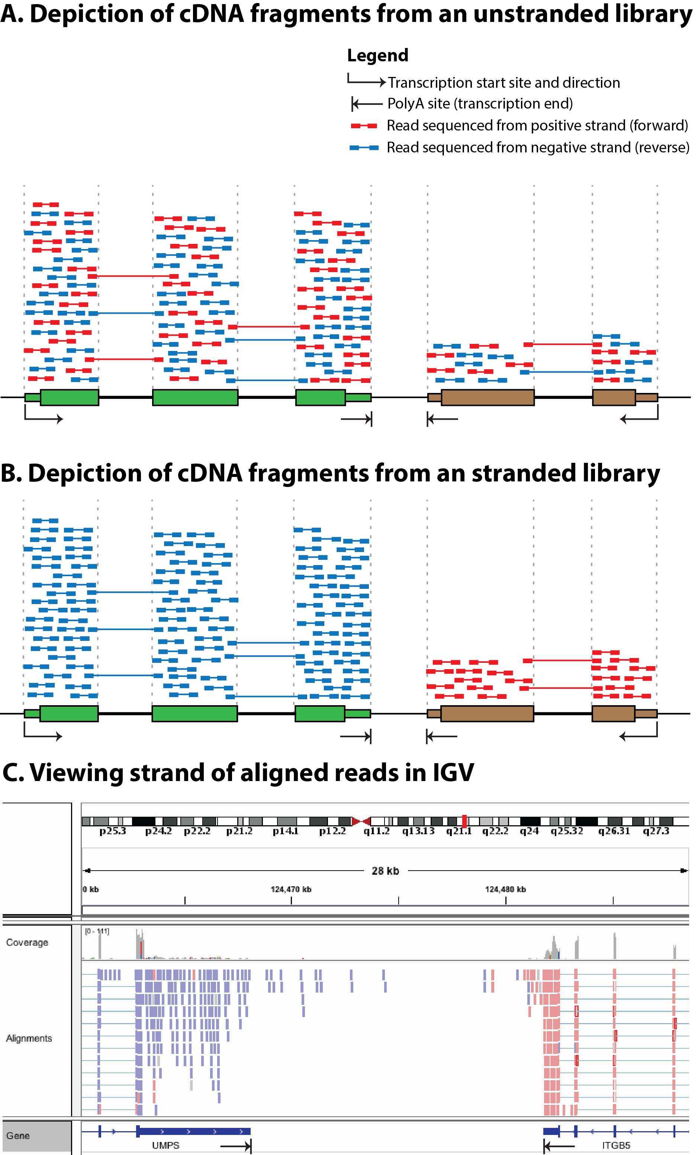
Stranded vs. unstranded
Notes:
Comparison of stranded and unstranded RNA-seq library methods and their influence on interpretation and analysis. (A) Many RNA-seq library construction protocols do not maintain the strand identity of RNA transcripts in the sequence data (S1 Table). In these “unstranded” strategies, doublestranded cDNA is sequenced, and knowledge of the transcription strand of the RNA molecule is lost. This results in an even mix of reads from both strands. In panel A, a gene transcribed on the positive strand is shown in green, a second gene transcribed on the negative strand is shown in brown, and a third gene transcribed on the positive strand (partially overlapping the second gene) is shown in yellow. The first two genes are protein coding with the open reading frame (ORF) portion depicted as thick rectangles and the UTRs depicted as thin rectangles. The third gene is a noncoding RNA gene. Aligned paired-end read sequences (read 1 and read 2) are depicted as short colored bars connected by thin lines. The thin connecting line in each read pair depicts the portion of the cDNA fragment that remains unsequenced when the cDNA fragment is larger than two times the read length. Each read is colored according to the strand sequenced, blue for the positive (forward/sense) strand and red for the negative (reverse/antisense) strand. Using known annotations, the mapped position of each read, and knowledge of exon splicing patterns, the likely transcription strand of some reads can be inferred. However, for many aligned reads the transcription strand cannot be inferred and sense-antisense expression analysis is not possible. Note that for each gene, an approximately equal proportion of reads corresponding to each strand are observed. Also note that read pairing information can sometimes be used to infer which gene a read was likely derived from. These reads are referred to as “encompassing” read pairs, in which one read of a pair aligns within one exon and the second read of a pair aligns within another exon. However, reads that align within a region corresponding to overlapping genes cannot be unambiguously assigned to either gene (e.g., the portion of the brown and yellow genes that overlap). Note that in this figure we are not depicting any reads in which a single read of a read pair spans across an intron. These exon–exon “spanning” reads can usually be matched unambiguously to a transcript, even in an unstranded library, because the exon–exon junction alignments line up with known splice sites and exon boundaries. (B) More recent “stranded” RNA-seq library strategies allow the strand information to be retained. In the resulting alignments, depicted in panel B, the strand of the alignment corresponds in a predictable way to the transcription strand of the sequenced RNA molecule. Now we see that reads aligning within a gene are indicated as being derived from the expected transcription strand for that gene. Furthermore, in regions where two genes overlap on opposite strands, we can now unambiguously assign reads to each gene. (C) When strand information is maintained by the RNA-seq protocol, it can be visualized in genome browsers such as IGV [62]. For example, to make IGV color read alignments according to strand, use the “Color alignments” by “First-of-pair strand” setting (refer to S5 Table for more strand-related software settings).

Slide 35
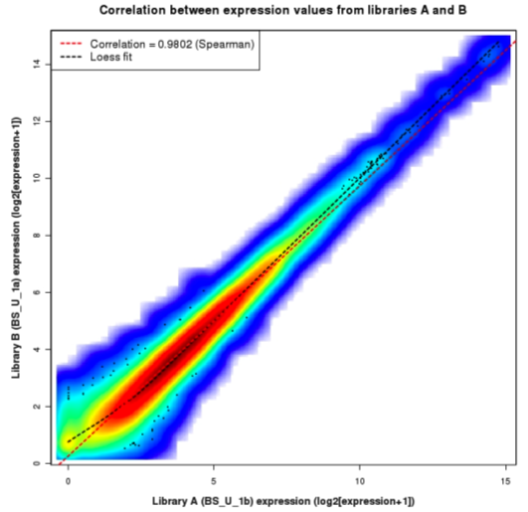
Replicates
Technical Replicate
Multiple instances of sequence generation
Flow Cells, Lanes, Indexes
Biological Replicate
Multiple isolations of cells showing the same phenotype, stage or other experimental condition
Some example concerns/challenges:
Environmental Factors, Growth Conditions, Time
Correlation Coefficient 0.92-0.98

Slide 36
Common analysis goals of RNA-Seq analysis (what can you ask of the data?)
Gene expression and differential expression
Alternative expression analysis
Transcript discovery and annotation
Allele specific expression
Relating to SNPs or mutations
Mutation discovery
Fusion detection
RNA editing

Slide 37
General themes of RNA-seq workflows
Each type of RNA-seq analysis has distinct requirements and challenges but also a common theme:
Obtain raw data (convert format)
Align/assemble reads
Process alignment with a tool specific to the goal
e.g. ‘StringTie’ for expression analysis, ‘STARfusion’ for fusion detection, etc.
Post process
Import into downstream software (R, Python, etc.)
Summarize and visualize
Create gene lists, prioritize candidates for validation, etc.

Slide 38
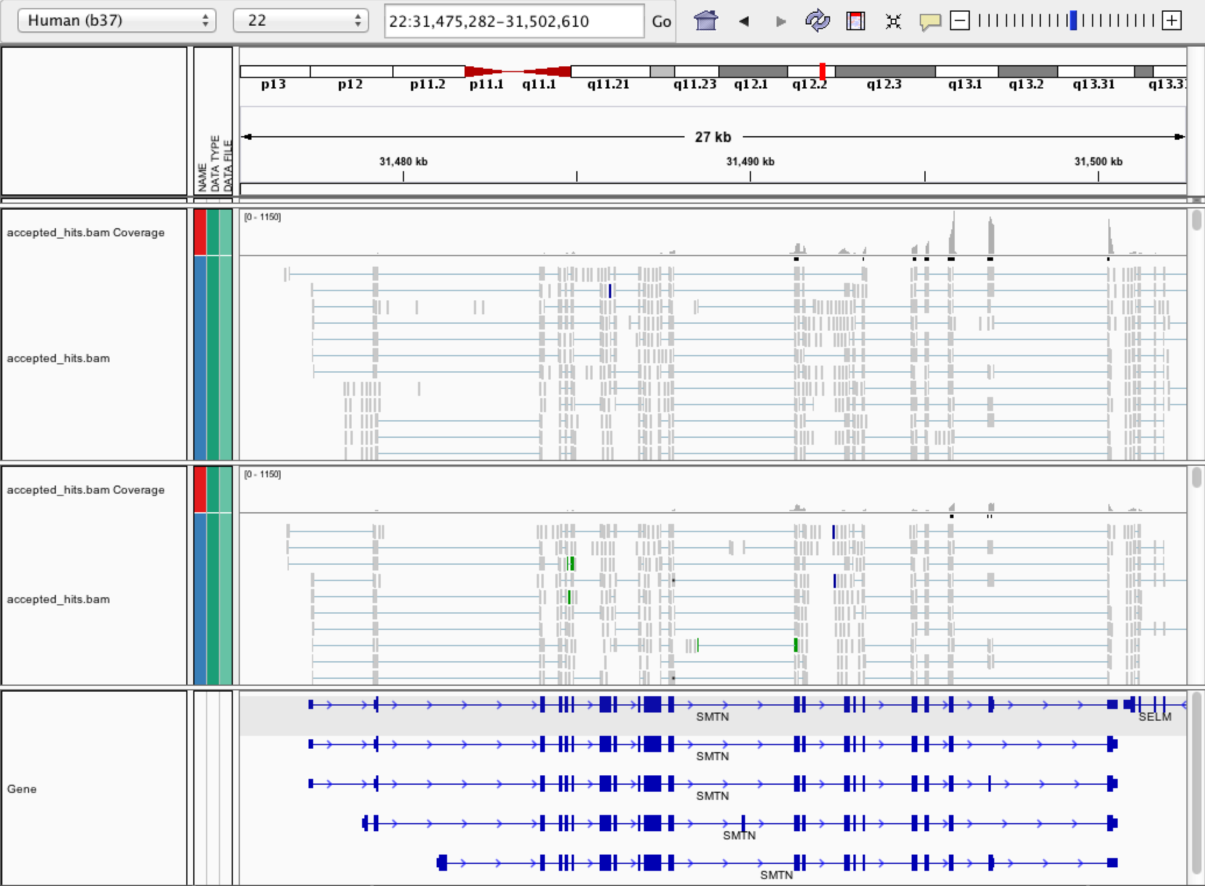
Expression estimation for known genes and transcripts
3’ bias
Down-regulated

Slide 39
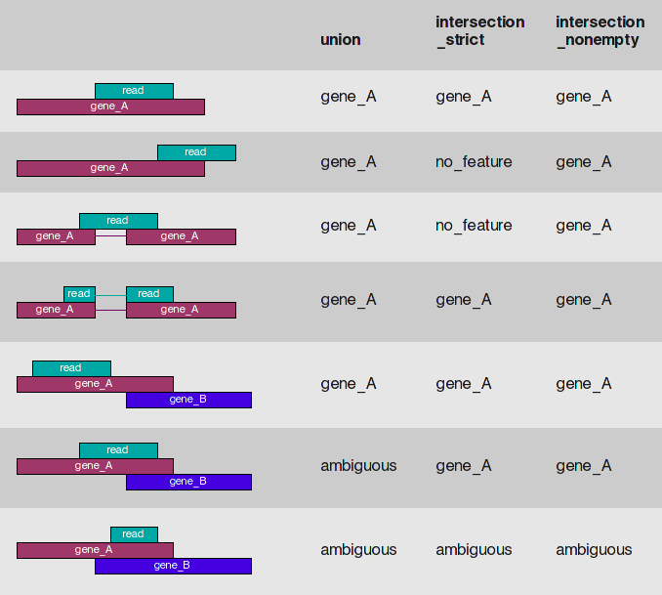
HTSeq-count basically counts reads supporting a feature (exon, gene) by assessing overlapping coordinates
Note, if gene_A and gene_B on opposite strands, sequence data is stranded, and correct HTSeq parameter set then this read may not be ambiguous
Whether a read is counted depends on the nature of overlap and “mode” selected
Notes:
We recommend intersection_strict

Slide 40
What is FPKM (RPKM)?
RPKM: Reads Per Kilobase of transcript per Million mapped reads.
FPKM: Fragments Per Kilobase of transcript per Million mapped reads.
No essential difference - Just a terminology change to better describe paired-end reads!

Slide 41
What is FPKM?
Why not just count reads in my RNAseq data?
The relative expression of a transcript is proportional to the number of cDNA fragments that originate from it. However:
# fragments is biased towards larger genes
# fragments is related to total library depth
Fragments
Per Kilobase of transcript
per Million mapped reads.

Slide 42
What is FPKM?
FPKM attempts to normalize for gene size and library depth
remember – RPKM is essentially the same!
C = number of mappable fragments for a gene (transcript)
N = total number of mappable fragments in the library
L = number of base pairs in the gene (transcript)
FPKM = (C / (N x L) ) x 1,000 x 1,000,000
FPKM = (1,000,000,000 x C) / (N x L)
FPKM = (C / (N / 1,000,000)) / (L/1000)
More reading:
http://www.biostars.org/p/11378/
http://www.biostars.org/p/68126/

Slide 43
How do FPKM and TPM differ?
TPM: Transcript per Kilobase Million
The difference is in the order of operations:
FPKM
1) Determine total fragment count, divide by 1,000,000 (per Million)
2) Divide each gene/transcript fragment count by #1 (Fragments Per Million)
3) Divide each FPM by length of each gene/transcript in kilobases (FPKM)
TPM
1) Divide each gene/transcript fragment count by length of the transcript in kilobases (Fragments Per Kilobase)
2) Sum all FPK values for the sample and divide by 1,000,000 (per Million)
3) Divide #1 by #2 (TPM)
The sum of all TPMs in each sample is the same. Easier to compare across samples!
http://www.rna-seqblog.com/rpkm-fpkm-and-tpm-clearly-explained/
https://www.ncbi.nlm.nih.gov/pubmed/22872506
Notes:
When you use TPM, the sum of all TPMs in each sample are the same. This makes it easier to compare the proportion of reads that mapped to a gene in each sample. In contrast, with RPKM and FPKM, the sum of the normalized reads in each sample may be different, and this makes it harder to compare samples directly.

Slide 44
‘FPKM/TPM’ expression estimates vs. ‘raw’ counts
Which should I use?
Long running debate, but the general consensus:
FPKM/TPM
When you want to leverage more holistic approaches
Transcript/Isoform deconvolution
Good for visualization (e.g., heatmaps)
Calculating fold changes, etc.
Counts
“More robust" statistical methods for differential expression
Accommodates more sophisticated experimental designs with appropriate statistical tests
Not suitable for transcript/isoform level estimation

Slide 45
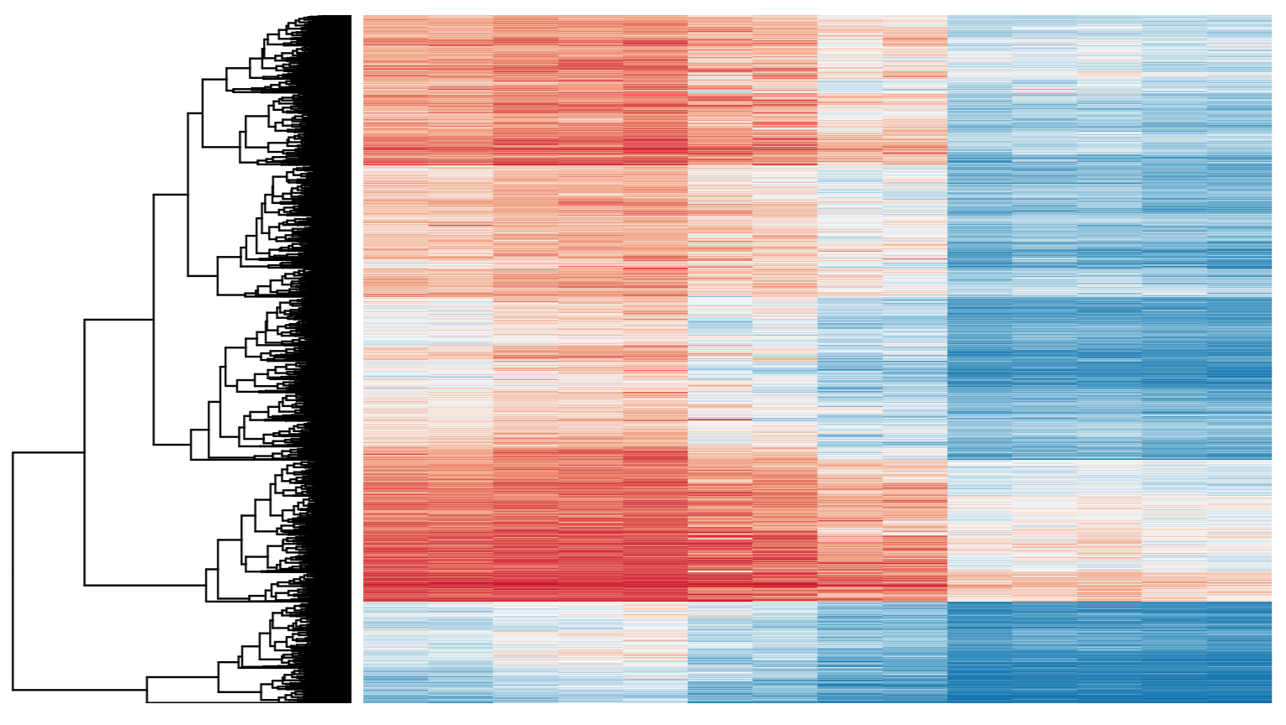
Differential Expression
Tying gene expression back to genotype/phenotype
What genes/transcripts are being expressed at higher/lower levels in different groups of samples?
Are these differences ‘significant’, accounting for variance/noise?

Slide 46

Examples of RNA-seq data analysis workflows for differential gene expression
Stark et al. 2019
Covered in rnabio.org
Notes:
RNA-seq data analysis workflow for differential gene expression. Computational analysis for differential gene expression (DGE) begins with raw RNA sequencing (RNA-seq) reads in FASTQ format and can follow a number of paths. Three popular workflows (A, B and C, represented by the solid lines) are given as examples, and some of the more common alternative tools (represented by the dashed lines) are indicated. In workflow A, aligners such as TopHat, STAR or HISAT2 use a reference genome to map reads to genomic locations, and then quantification tools, such as HTSeq and featureCounts, assign reads to features. After normalization (usually using methods embedded in the quantification or expression modelling tools, such as trimmed mean of M-values (TMM)), gene expression is modelled using tools such as edgeR, DESeq2 and limma+voom, and a list of differentially expressed genes or transcripts is generated for further visualization and interpretation. In workflow B, newer, alignment-free tools, such as Kallisto and Salmon, assemble a transcriptome and quantify abundance in one step. The output from these tools is usually converted to count estimates (using tximport (TXI)) and run through the same normalization and modelling used in workflow A, to output a list of differentially expressed genes or transcripts. Alternatively, workflow C begins by aligning the reads (typically performed with TopHat, although STAR and HISAT can also be used), followed by the use of CuffLinks to process raw reads and the CuffDiff2 package to output transcript abundance estimates and a list of differentially expressed genes or transcripts. Other tools in common use include StringTie, which assembles a transcriptome model from TopHat (or similar tools) before the results are passed through to RSEM or MMSEQ to estimate transcript abundance, and then to Ballgown to identify differentially expressed genes or transcripts, and SOAPdenovo-trans, which simultaneously aligns and assembles reads for analysis via the path of choice.

Slide 47

Multiple approaches advisable

Slide 48
Lessons learned from microarray days
Hansen et al. “Sequencing Technology Does Not Eliminate Biological Variability.” Nature Biotechnology 29, no. 7 (2011): 572–573.
Power analysis for RNA-seq experiments
http://scotty.genetics.utah.edu/
RNA-seq need for biological replicates
http://www.biostars.org/p/1161/
RNA-seq study design
http://www.biostars.org/p/68885/

Slide 49
Multiple testing correction
As more attributes are compared, differences due solely to chance become more likely!
Well known from array studies
10,000s genes/transcripts
100,000s exons
With RNA-seq, more of a problem than ever
All the complexity of the transcriptome gives huge numbers of potential features
Genes, transcripts, exons, junctions, retained introns, microRNAs, lncRNAs, etc
Bioconductor multtest
http://www.bioconductor.org/packages/release/bioc/html/multtest.html

Slide 50
Downstream interpretation of expression analysis
Topic for an entire course
Expression estimates and differential expression lists from StringTie, Ballgown or other alternatives can be fed into many analysis pipelines
See supplemental R tutorial for how to format expression data and start manipulating in R
Clustering/Heatmaps
Provided by Ballgown
For more customized analysis various R packages exist:
hclust, heatmap.2, plotrix, ggplot2, etc.
Classification
Weka is a good learning tool
RandomForests R package
Pathway analysis
GSEA, IPA, Cytoscape, many R/BioConductor packages: http://www.bioconductor.org/help/search/index.html?q=pathway
https://genviz.org/module-04-expression/0004/01/01/Expression_Profiling_and_Visualization/

Slide 51

Discussion of bulk vs single cell RNA-seq
Image from 10x genomics
Factors to compare: Cost, complexity of library prep, complexity of analysis, qualitative and quantitative differences in richness of information obtained.
Notes:
Simple differences. Cost. 200 million reads gives you a rich representation of transcriptome in bulk context but signal is averaged across cells. 500 million reads in an scRNA-seq experiment by contrast gives you are relatively sparse view of the transcriptome of 4-10k individual cells.
Simple differences. Complexity of library prep and analysis is higher for scRNA.
Most importantly. Single cell data gives information about individual cells. In bulk RNAseq analysis the signal from multiple cells is averaged together. Deconvolution approaches are possible with bulk RNA-seq but hard. Single cell becomes more valuable depending on how heterogeneous your sample is, and how important it is to understand the composition of cell types present and interaction between cells.
Bulk RNA-seq is giving a readout of more cells, way, way, way more cells
Bulk RNA-seq can robustly detect gene expressed at a very low copy number per cell
Bulk RNA-seq can provide information from the whole length of transcripts. Single cell protocols remain end biased. This has implications for detecting expression of variant alleles, isoform quantification, fusion detection, etc.
Support of long read sequencing platforms is in the early stages for the scRNA approach
Bulk RNAseq can be done with very minimal manipulation of cells. The result may be a relatively unbiased survey of transcripts in that tissue. polyA transcripts and those that are not. Long transcripts, short transcripts, abundant and rare. Transcripts from cells that are fragile. Transcripts from cells that are large and small.

Slide 52

Steps upstream of the hands-on exercises

Slide 53
Introduction to rnabio.org

Slide 54
We are on a Coffee Break & Networking Session

Slide 55
Processing of NGS data (Illumina data)
De-multiplexing
Alignment
Alignment algorithms (pseudo-alignment?)
DNA vs RNA
Coverage metrics
Alignment metrics
Reference data
Human reference genome
Gene annotation
Ensembl
File formats (e.g. GTF, fasta)
Somatic profiling of tumors
Somatic variant calling
Algorithms/software types
Mutation annotation
VCF files
Validation across data types
Command line- Where can I run these processes?
Walk through (don’t actually run) of steps
File formats/manipulation
Alignment
Gene expression quantification
Gene vs. transcript expression
Metrics
Challenges
Why isn’t a gene expressed?
Differential expression
Visualizations
Pathway analysis
Batch correction
Other considerations

Slide 56
Introduction to course – philosophy and goals
Do “the bioinformatics” for someone, and you help them for a day. Teach someone to do bioinformatics, and you help them for a lifetime.
- Ancient Chinese proverb
Course goals
Learn concepts and develop skills for sequence analysis
Build the foundation for tackling your own analysis challenges
Learn to think like a bioinformatician
Have fun

Slide 57





First cancer whole genomes sequenced in last 10 years
2008 - AML
2009 - Breast
2010 - SCLC
2010 - MEL
2011 - PRC

Slide 58

Cancer genomics has experienced a decade of explosive growth with large international initiatives (TCGA and ICGC)

Slide 59

Deeper sequencing reveals hidden tumor architecture
Griffith, Miller et al. Cell Systems. 2015

Slide 60
Alternatives to FPKM/TPM
Raw read counts for differential expression analysis
Assign reads/fragments to defined genes/transcripts, get “raw counts”
Transcript structures could still be defined by something like Stringtie
HTSeq (htseq-count)
https://htseq.readthedocs.io/
Caveats of ‘transcript’ analysis by htseq-count:
Designed for genes - ambiguous reads from overlapping transcripts may not be handled!
http://seqanswers.com/forums/showthread.php?t=18068
htseq-count --mode intersection-strict --stranded no --minaqual 1 --type exon --idattr transcript_id accepted_hits.sam chr22.gff > transcript_read_counts_table.tsv

Slide 61

How does StringTie work?
Align reads to the genome, optionally assemble super-reads and re-align
Group reads into clusters
Infer isoforms:
Build alternative splice graph (ASG)
Iteratively extract the heaviest path from a splice graph
construct a flow network
compute maximum flow to estimate abundance
update the splice graph by removing reads that were assigned by the flow algorithm
This process repeats until all reads have been assigned.
Pertea et al. Nature Biotechnology, 2015
Notes:
The StringTie algorithm optionally accepts RNA-seq reads that are assembled into super-reads (Step 1).
Super-reads plus un-assembled reads or just un-assembled reads (if skipping super-read assembly step) are mapped to the genome (Step 2).
In Step 3, mapped reads (and super-reads) are grouped into clusters. Basically, any reads aligned within some minimum distance (configurable) are grouped together. Each cluster is used to build an alternative splice graph (ASG). The ASG captures all possible transcripts that are consistent with the mapped reads, where nodes in the graph correspond to contiguous regions of the genome that are uninterrupted by any spliced read alignment, and directed edges correspond to reads that align across two such nodes in the correct 5′ to 3′ order.
The path from source (s) to sink (t) with the heaviest coverage is used to build a flow network corresponding to the transcript represented by that path (Step 4).
The maximum flow in this network represents the coverage of one assembled transcript, which is removed from the splice graph (Step 5). Steps 4 and 5 are repeated until no more transcripts can be assembled.

Slide 62

From flow network for each transcript, maximum flow is used to assemble transcript and estimate abundance
StringTie uses basic graph theory (splice graph), custom heuristics (heaviest path), more graph theory (flow network) and optimization theory (maximum flow). See StringTie paper for definitions and math.
Notes:
Flow network associated with a transcript (shown with colored nodes). 15 fragments (shown in grey) align to the transcript. Two nodes in the flow network are connected if a fragment starts and ends at those nodes. E.g., nodes 1 and 5 are connected because fragment (a) starts at node 1 and ends at node 5. For each colored node in the transcript, two nodes are created in the flow network. Capacities on edges (not connecting source or sink) are shown in red.
In the first node (corresponding to exon1) there are 7 fragments. One of these fragments is connected to exon5 (starts at beginning of exon1 and ends at end of exon5), while 6 fragments are connected to exon3. In the second node (corresponding to exon3) there are 13 fragments, of which 3 are connected to exon 5. The final node (corresponding to exon5) has 4 supporting fragments. The maximum flow is clearly 1 – 3 – 5.
StringTie estimates the coverage level of the transcript by solving a maximum-flow problem that determines the maximum number of fragments that can be associated with the chosen transcript.
The maximum flow problem is a well-studied problem in optimization theory.

Slide 63
StringTie Modes
Expression estimation mode (“Reference Only”)
“–G $GTF_File” AND “–e” option
no "novel" transcript assemblies (isoforms)
read alignments not overlapping reference transcripts ignored
Faster, especially when given limited set of reference transcripts
Avoids complicated steps of clustering and building alternative splice graph from scratch, skipping straight to abundance estimation
“Reference guided mode”
“–G $GTF_File” WITHOUT “–e” option
Both known and novel transcript assemblies
“De novo” mode
NEITHER “–G $GTF_File” NOR “–e” option
Novel transcript assemblies only
Pertea et al. Nature Protocols, 2016

Slide 64
StringTie -merge
Merge together all gene structures from all samples
Some samples may only partially represent a gene structure
Incorporates known transcripts with assembled, potentially novel transcripts
For de novo or reference guided mode, we will rerun StringTie with the merged transcript assembly.
Pertea et al. Nature Protocols, 2016

Slide 65

gffcompare
gffcompare will compare a merged transcript GTF with known annotation, also in GTF/GFF3 format
http://cole-trapnell-lab.github.io/cufflinks/cuffcompare/index.html#cuffcompare-output-files

Slide 66
Differential Expression with Ballgown
Parametric F-test comparing nested linear models
Two models are fit to each feature, using expression as the outcome
one including the covariate of interest (e.g., case/control status or time) and one not including that covariate.
An F statistic and p-value are calculated using the fits of the two models.
A significant p-value means the model including the covariate of interest fits significantly better than the model without that covariate, indicating differential expression.
Adjust for multiple testing by reporting q-values:
q < 0.05 the false discovery rate should be controlled at ~5%.
Frazee et al. (2014)

Slide 67




Ballgown for Visualization with R

Slide 68
Alternative differential expression methods
Raw count approaches
DESeq2 - http://www-huber.embl.de/users/anders/DESeq/
edgeR - http://www.bioconductor.org/packages/release/bioc/html/edgeR.html
Others…

